Slide 1
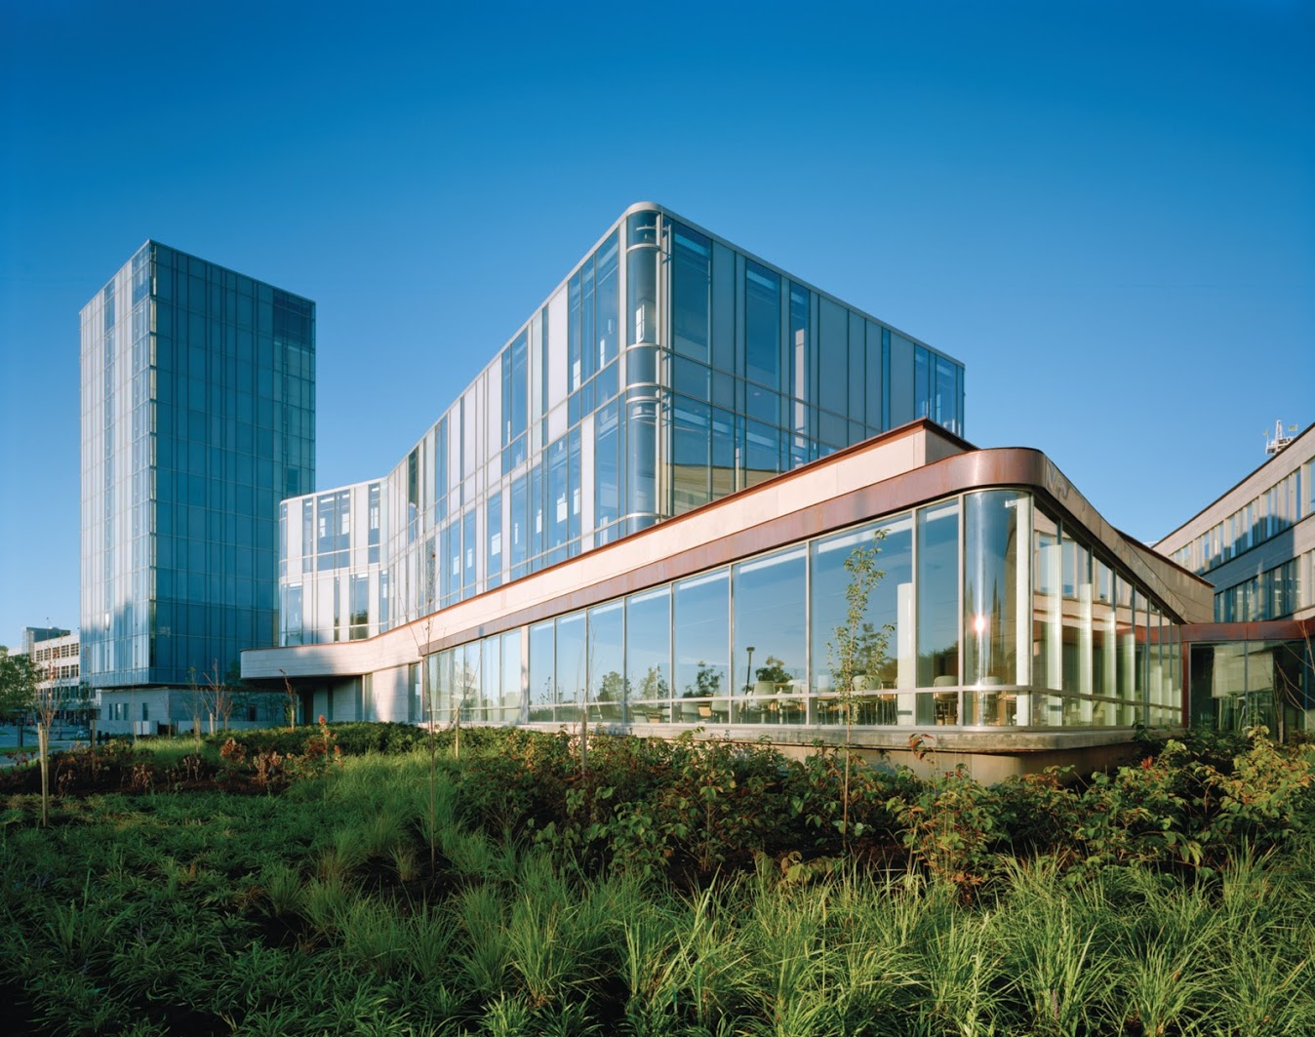
`
Schulich School of Business MBAN 6120
MODULE 4 : Time series regression
Data Science II
Instructor: Boris Garbuzov
MBAN 6120
Winter 2020
SCHULICH SCHOOL OF BUSINESS | MBAN 6120
MODULE 1
Data Science II
2020

Slide 2
Chapter 2 Time Series Regression and Exploratory Data Analysis
2.1 Classical Regression in the Time Series Context

Slide 3
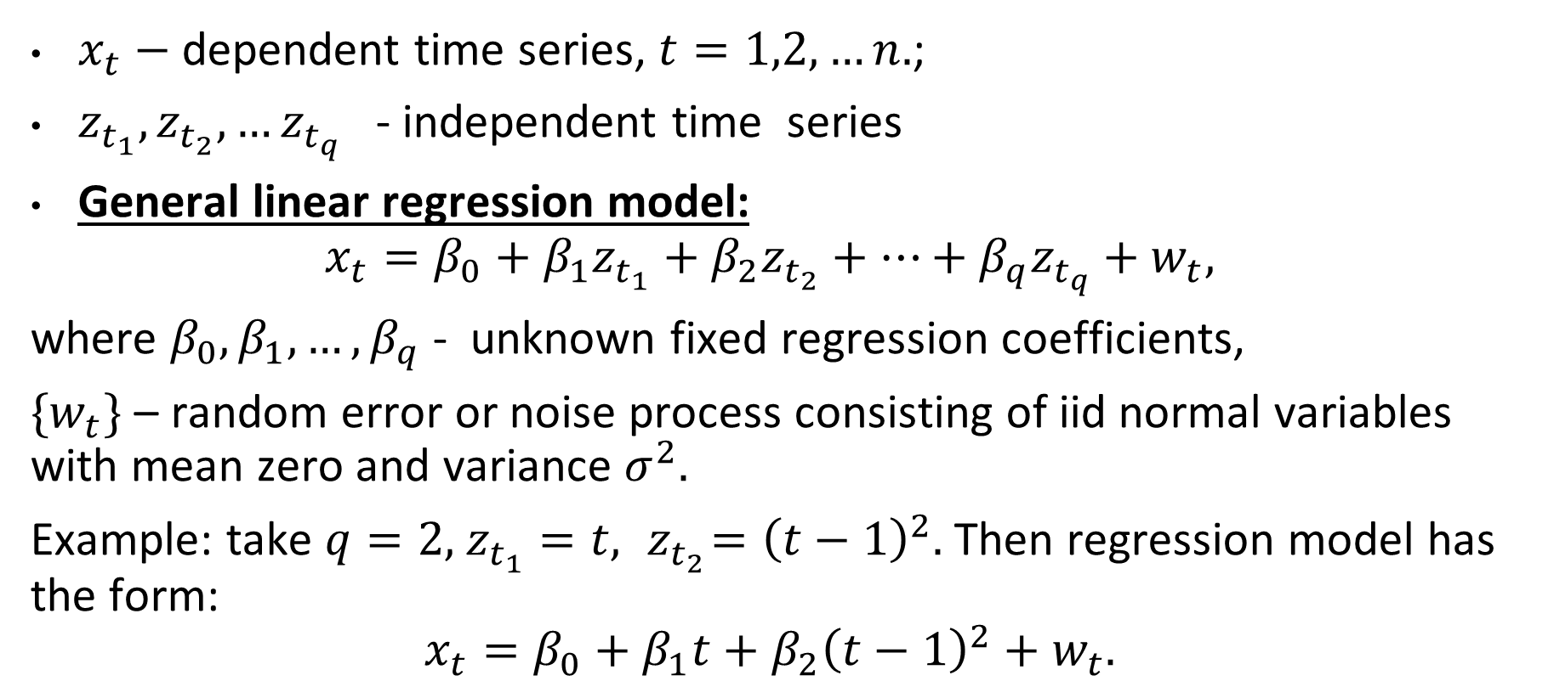
Linear regression model
$x_{t}−$ dependent time series, $t=1,2,…n.$;
$z_{t_{1}}, z_{t_{2}}, …z_{t_{q}}$ - independent time series
General linear regression model:
$$x_{t}=β_{0}+β_{1}z_{t_{1}}+β_{2}z_{t_{2}}+…+β_{q}z_{t_{q}}+w_{t},$$
where $β_{0},β_{1},…, β_{q}$- unknown fixed regression coefficients,
$\{w_{t}\}$ – random error or noise process consisting of iid normal variables with mean zero and variance $σ^{2}.$
Example: take $q=2,$ $z_{t_{1}}=t, { z}_{t_{2}}={\left(t−1\right)}^{2}.$Then regression model has the form:
$$x_{t}=β_{0}+β_{1}t+β_{2}{\left(t−1\right)}^{2}+w_{t}.$$

Slide 4
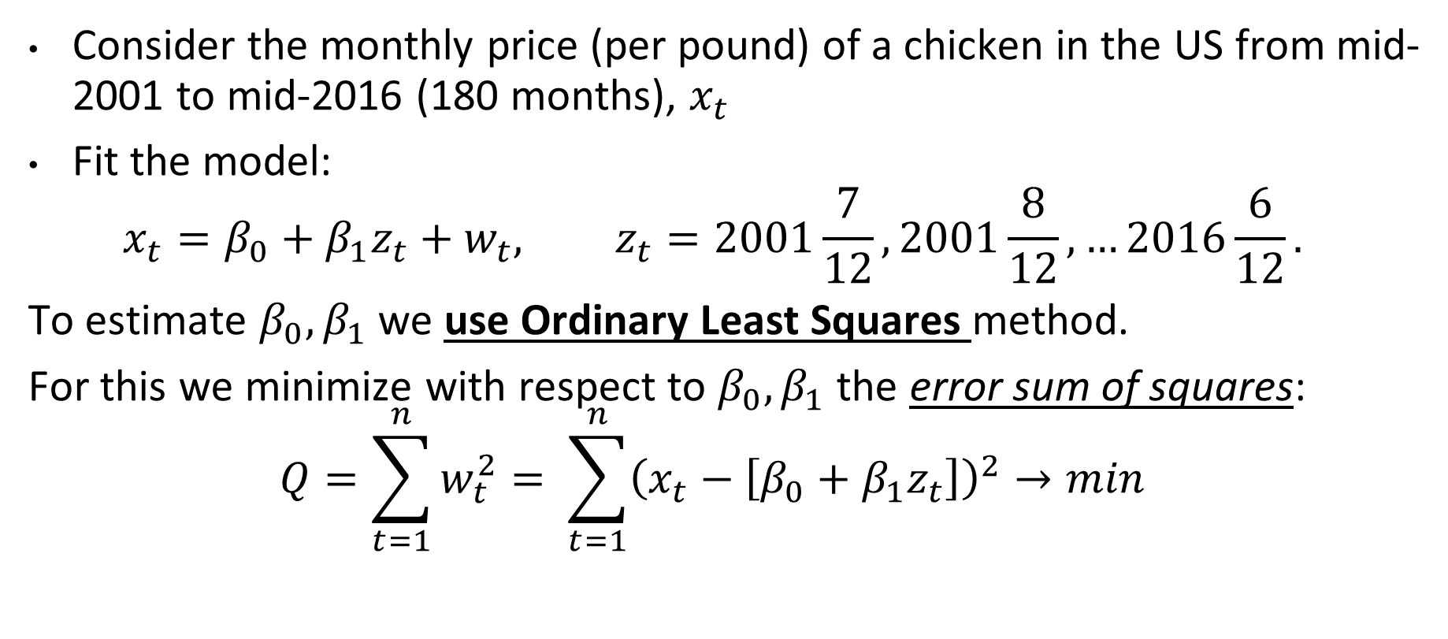
Estimating a Linear Trend
Consider the monthly price (per pound) of a chicken in the US from mid-2001 to mid-2016 (180 months), $x_{t}$
Fit the model:
$$x_{t}=β_{0}+β_{1}z_{t}+w_{t}, z_{t}=2001\frac{7}{12}, 2001\frac{8}{12},…2016\frac{6}{12}.$$
To estimate $β_{0}, β_{1}$we use Ordinary Least Squares method.
For this we minimize with respect to $β_{0}, β_{1}$ the error sum of squares:
$$Q=\sum_{t=1}^{n}{w_{t}^{2}}= \sum_{t=1}^{n}{{\left(x_{t}−\left[β_{0}+β_{1}z_{t}\right]\right)}^{2}}→min$$

Slide 5
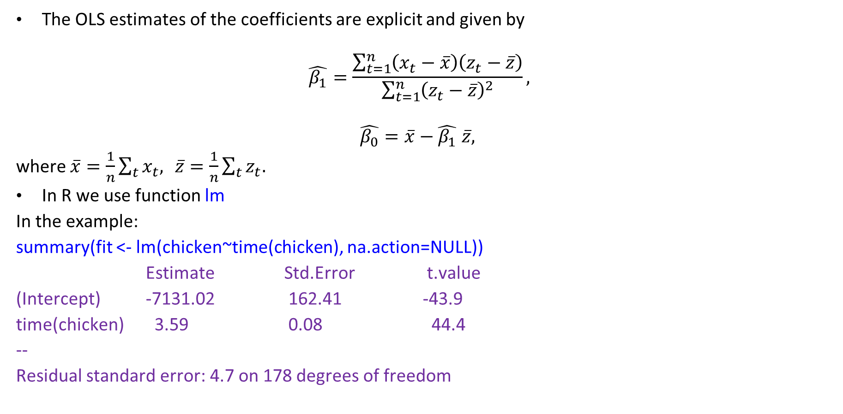
Estimating a Linear Trend (continued)
The OLS estimates of the coefficients are explicit and given by
$$\hat{β_{1}}=\frac{\sum_{t=1}^{n}{\left(x_{t}−\overline{x}\right)\left(z_{t}−\overline{z}\right)}}{\sum_{t=1}^{n}{{\left(z_{t}−\overline{z}\right)}^{2}}},$$
$$\hat{β_{0}}=\overline{x}−\hat{β_{1}} \overline{z},$$
where $\overline{x}=\frac{1}{n}\sum_{t}{x_{t}, } \overline{z}=\frac{1}{n}\sum_{t}{z_{t}.}$
In R we use function lm
In the example:
summary(fit <- lm(chicken~time(chicken), na.action=NULL))
Estimate Std.Error t.value
(Intercept) -7131.02 162.41 -43.9
time(chicken) 3.59 0.08 44.4
--
Residual standard error: 4.7 on 178 degrees of freedom

Slide 6
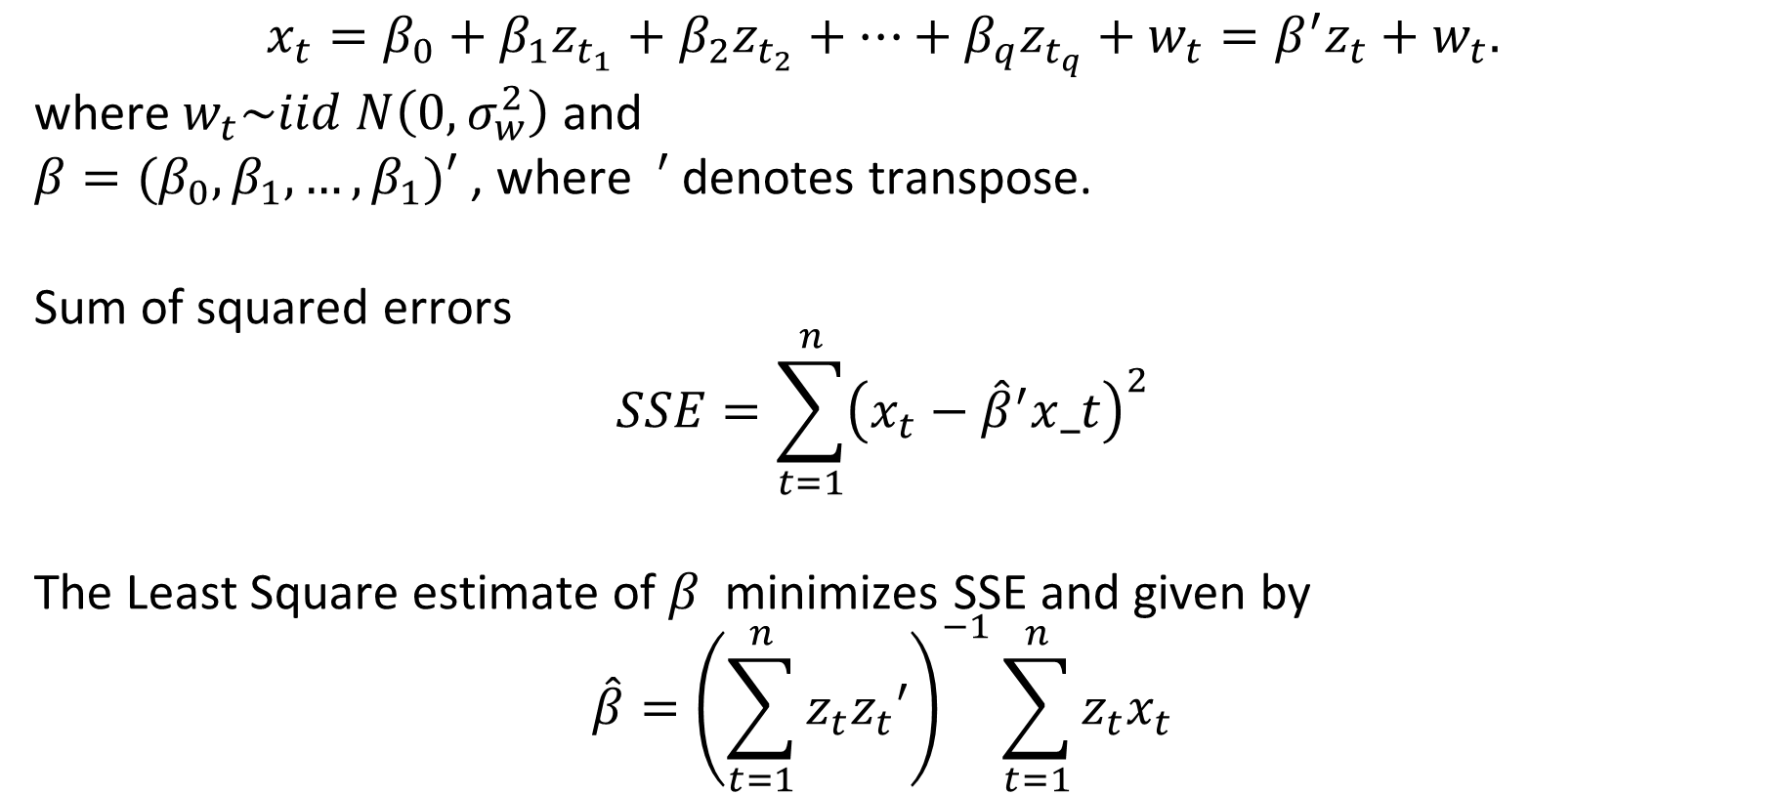
Multiple linear regression
$$x_{t}=β_{0}+β_{1}z_{t_{1}}+β_{2}z_{t_{2}}+…+β_{q}z_{t_{q}}+w_{t}=β^{′}z_{t}+w_{t}.$$
where $w_{t}\sim iid N\left(0,σ_{w}^{2}\right)$ and
$β=(β_{0}, β_{1},…, β_{1})′$ , where $′$denotes transpose.
Sum of squared errors
$$SSE=\sum_{t=1}^{n}{{\left(x_{t}−{\hat{β}}^{′}x_t\right)}^{2}}$$
The Least Square estimate of $β$ minimizes SSE and given by
$$\hat{β}={\left(\sum_{t=1}^{n}{z_{t}z_{t}′}\right)}^{−1}\sum_{t=1}^{n}{z_{t}x_{t}}$$

Slide 7
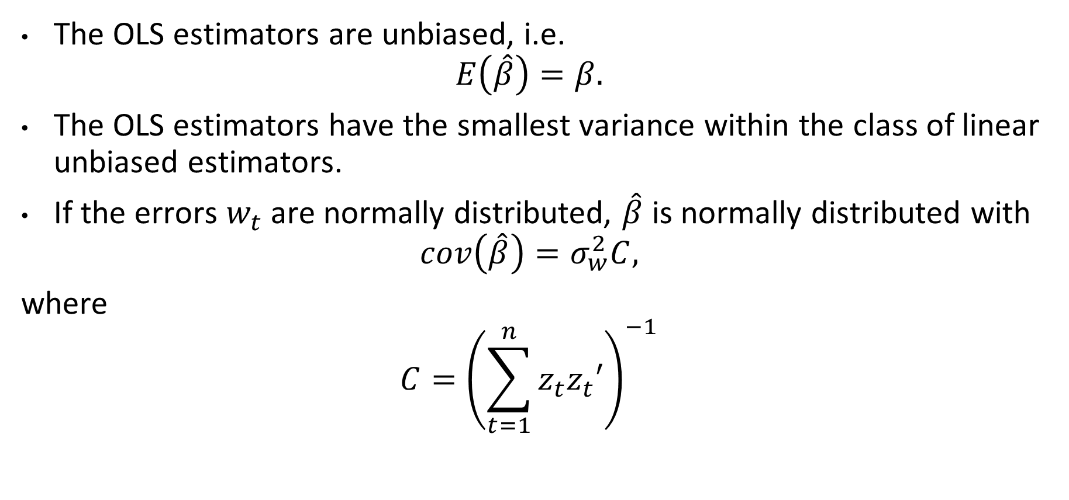
Properties of OLS estimators
The OLS estimators are unbiased, i.e.
$$E\left(\hat{β}\right)=β.$$
The OLS estimators have the smallest variance within the class of linear unbiased estimators.
If the errors $w_{t}$ are normally distributed, $\hat{β}$ is normally distributed with
$$cov\left(\hat{β}\right)=σ_{w}^{2}C,$$
where
$$C={\left(\sum_{t=1}^{n}{z_{t}z_{t}′}\right)}^{−1}$$

Slide 8
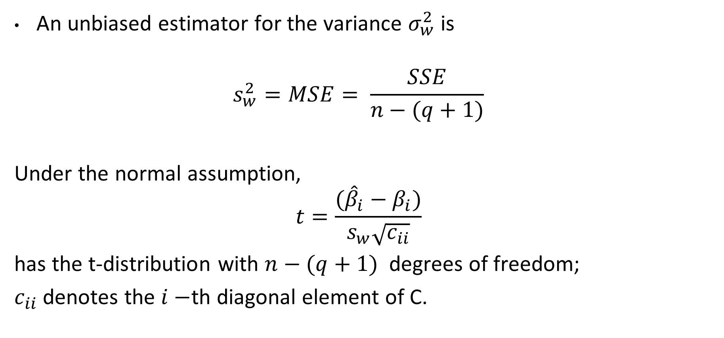
Properties of OLS estimators
An unbiased estimator for the variance $σ_{w}^{2}$ is
$$s_{w}^{2}=MSE= \frac{SSE}{n−(q+1)}$$
Under the normal assumption,
$$t=\frac{({\hat{β}}_{i}−β_{i})}{s_{w}\sqrt{c_{ii}}}$$
has the t-distribution with $n−(q+1)$ degrees of freedom;
$c_{ii}$ denotes the $i−$th diagonal element of C.

Slide 9
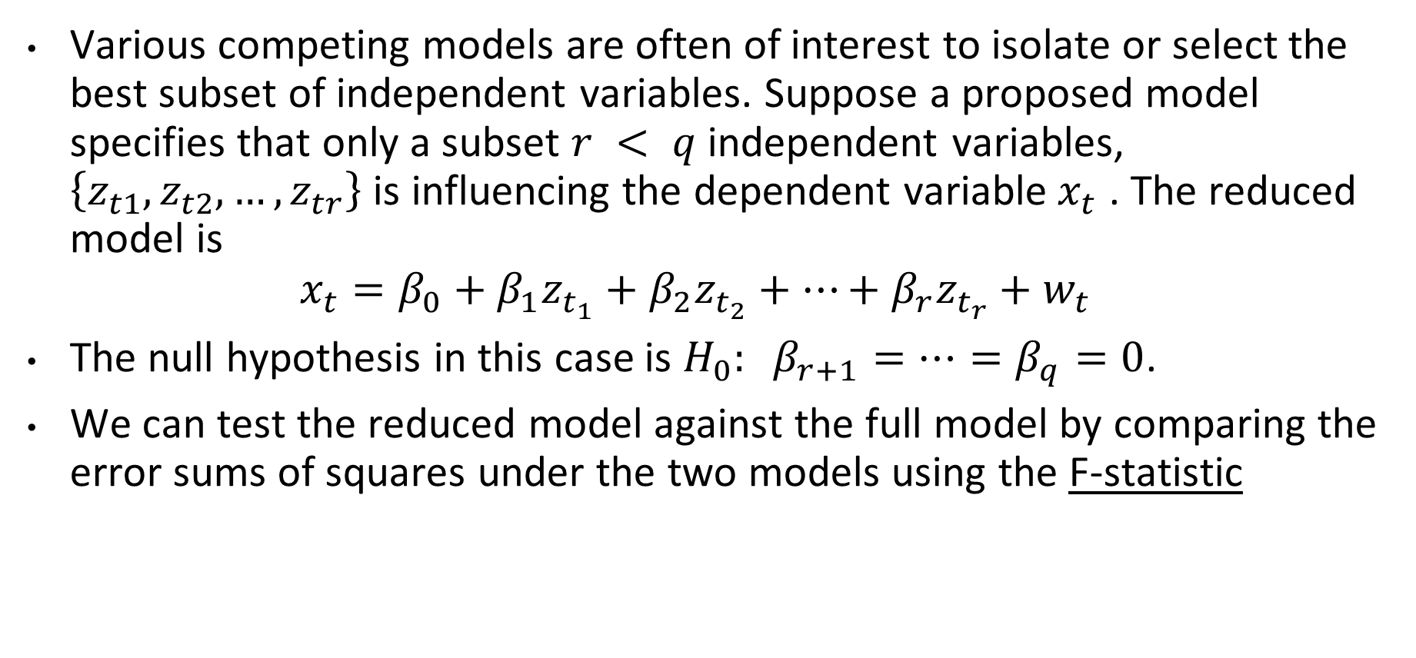
Reduced linear model
Various competing models are often of interest to isolate or select the best subset of independent variables. Suppose a proposed model specifies that only a subset $r < q$ independent variables, $\left\{z_{t1},z_{t2},…,z_{tr}\right\}$ is influencing the dependent variable$x_{t}$ . The reduced model is
$$x_{t}=β_{0}+β_{1}z_{t_{1}}+β_{2}z_{t_{2}}+…+β_{r}z_{t_{r}}+w_{t}$$
The null hypothesis in this case is $H_{0}: β_{r+1}=…=β_{q}=0$.
We can test the reduced model against the full model by comparing the error sums of squares under the two models using the F-statistic

Slide 10
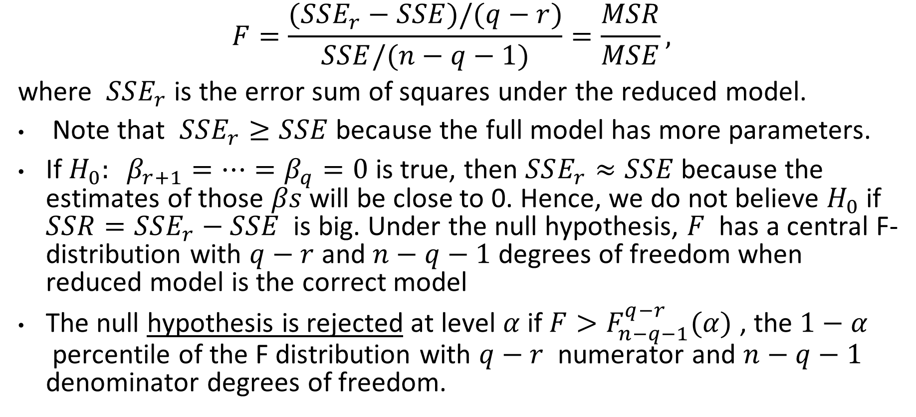
Reduced linear model: F-statistic for null-hypothesis
$$F=\frac{(SSE_{r}−SSE)/(q−r)}{SSE/(n−q−1)}=\frac{MSR}{MSE},$$
where $SSE_{r}$ is the error sum of squares under the reduced model.
Note that $SSE_{r}≥SSE$ because the full model has more parameters.
If $H_{0}: β_{r+1}=…=β_{q}=0$ is true, then $SSE_{r}≈SSE$ because the estimates of those $βs$ will be close to 0. Hence, we do not believe $H_{0}$ if $SSR=SSE_{r}−SSE$ is big. Under the null hypothesis, $F$ has a central F-distribution with $q−r$and $n−q−1$degrees of freedom when reduced model is the correct model
The null hypothesis is rejected at level $α$if $F>F_{n−q−1}^{q−r}(α)$ , the $1−α$ percentile of the F distribution with $q−r$ numerator and $n−q−1$ denominator degrees of freedom.

Slide 11
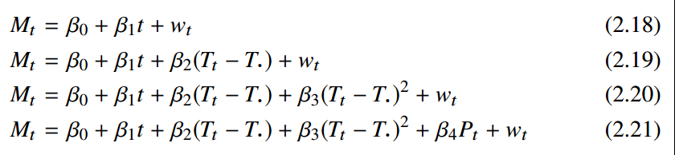
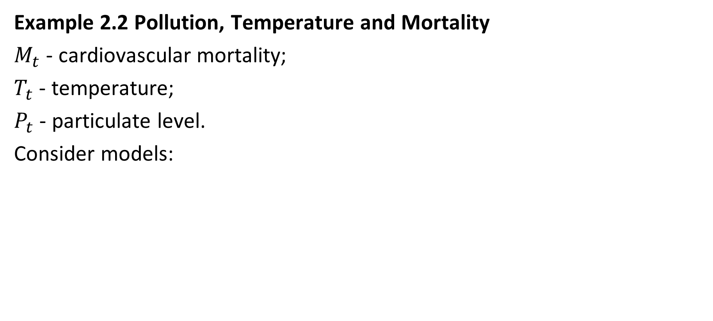
Example: choosing best model
Example 2.2 Pollution, Temperature and Mortality
$M_{t}$ - cardiovascular mortality;
$T_{t}$ - temperature;
$P_{t}$ - particulate level.
Consider models:

Slide 12
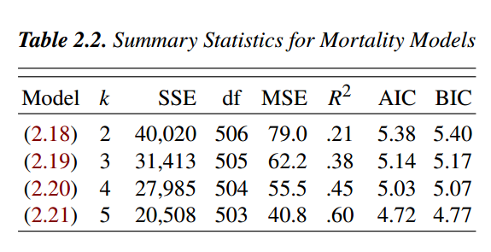
Example: choosing best model
Example 2.2 Pollution, Temperature and Mortality
We note that each model does substantially better than the one before it and that the model including temperature, temperature squared, and particulates does the best, accounting for some 60% of the variability and with the best value for AIC and BIC (because of the large sample size, AIC and AICc are nearly the same).

Slide 13
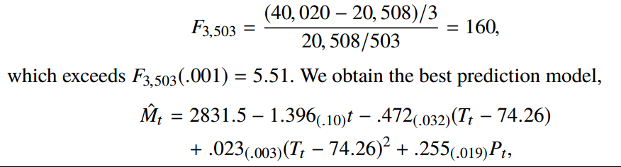
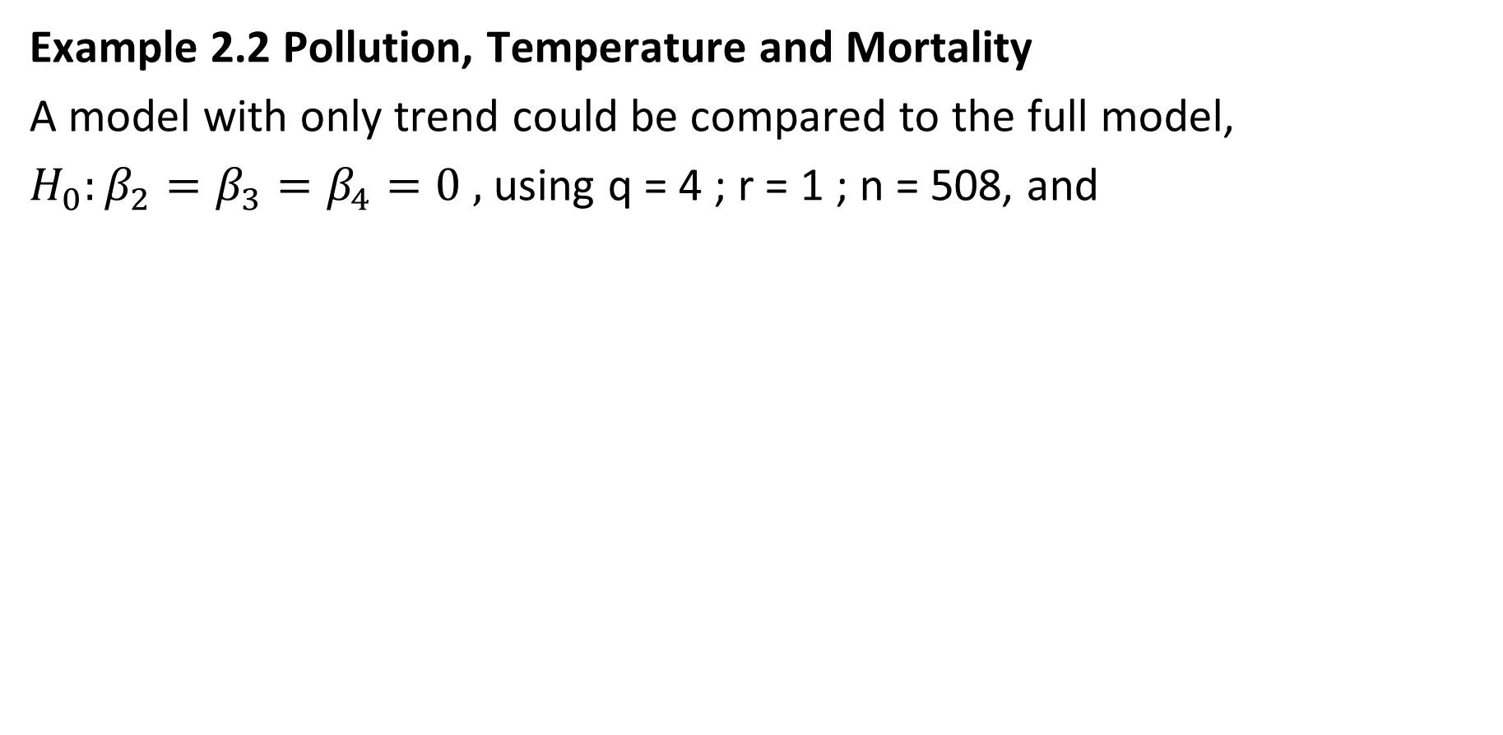
Example: choosing best model
Example 2.2 Pollution, Temperature and Mortality
A model with only trend could be compared to the full model,
$H_{0}:β_{2}=β_{3}=β_{4}=0 ,$ using q = 4 ; r = 1 ; n = 508, and

Slide 14
Example: choosing best model
par(mfrow=c(3,1)) # plot the data
plot(cmort, main="Cardiovascular Mortality", xlab="", ylab="")
plot(tempr, main="Temperature", xlab="", ylab="")
plot(part, main="Particulates", xlab="", ylab="")
dev.new() # open a new graphic device
ts.plot(cmort,tempr,part, col=1:3) # all on same plot (not shown)
dev.new()
pairs(cbind(Mortality=cmort, Temperature=tempr, Particulates=part))
temp = tempr-mean(tempr) # center temperature
temp2 = temp^2
trend = time(cmort) # time
fit = lm(cmort~ trend + temp + temp2 + part, na.action=NULL)
summary(fit) # regression results
summary(aov(fit)) # ANOVA table (compare to next line)
summary(aov(lm(cmort~cbind(trend, temp, temp2, part)))) # Table 2.1
num = length(cmort) # sample size
AIC(fit)/num - log(2*pi) # AIC
BIC(fit)/num - log(2*pi) # BIC
(AICc = log(sum(resid(fit)^2)/num) + (num+5)/(num-5-2)) # AICc

Slide 15
Regression quiz. Qualitative
1. To find the linear trend, we need to regress the time series values onto:
Time
Deterministic periodic function of time
Lag of the same time series
White noise
2. To find the seasonal trend, we need to regress the time series values onto:
Time
Deterministic periodic function of time
Lag of the same time series
White noise

Slide 16
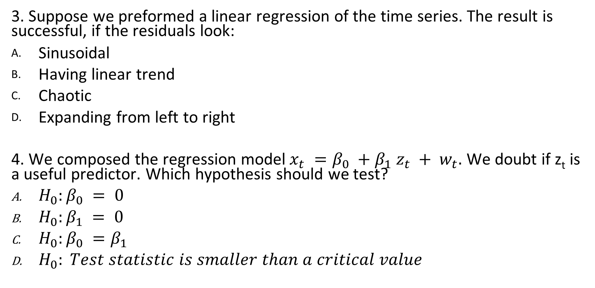
Regression quiz. Qualitative
3. Suppose we preformed a linear regression of the time series. The result is successful, if the residuals look:
Sinusoidal
Having linear trend
Chaotic
Expanding from left to right
4. We composed the regression model$x_{t} =β_{0} +β_{1} z_{t} + w_{t}.$ We doubt if z_{t} is a useful predictor. Which hypothesis should we test?
$H_{0}:β_{0} = 0$
$H_{0}:β_{1} = 0$
$H_{0}:β_{0} =β_{1}$
$H_{0}: Test statistic is smaller than a critical value$

Slide 17
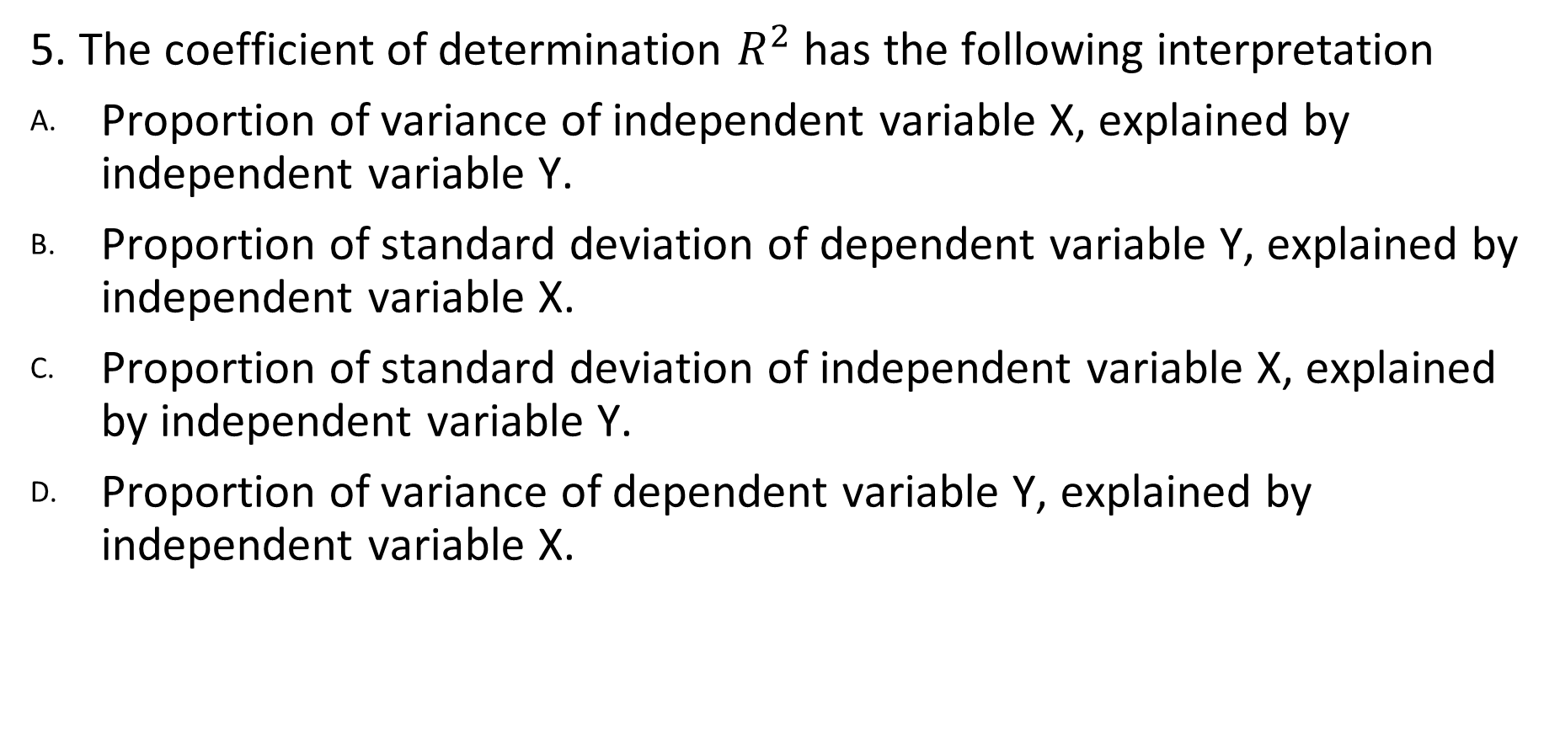
Regression quiz. Qualitative
5. The coefficient of determination $R^{2}$ has the following interpretation
Proportion of variance of independent variable X, explained by independent variable Y.
Proportion of standard deviation of dependent variable Y, explained by independent variable X.
Proportion of standard deviation of independent variable X, explained by independent variable Y.
Proportion of variance of dependent variable Y, explained by independent variable X.

Slide 18
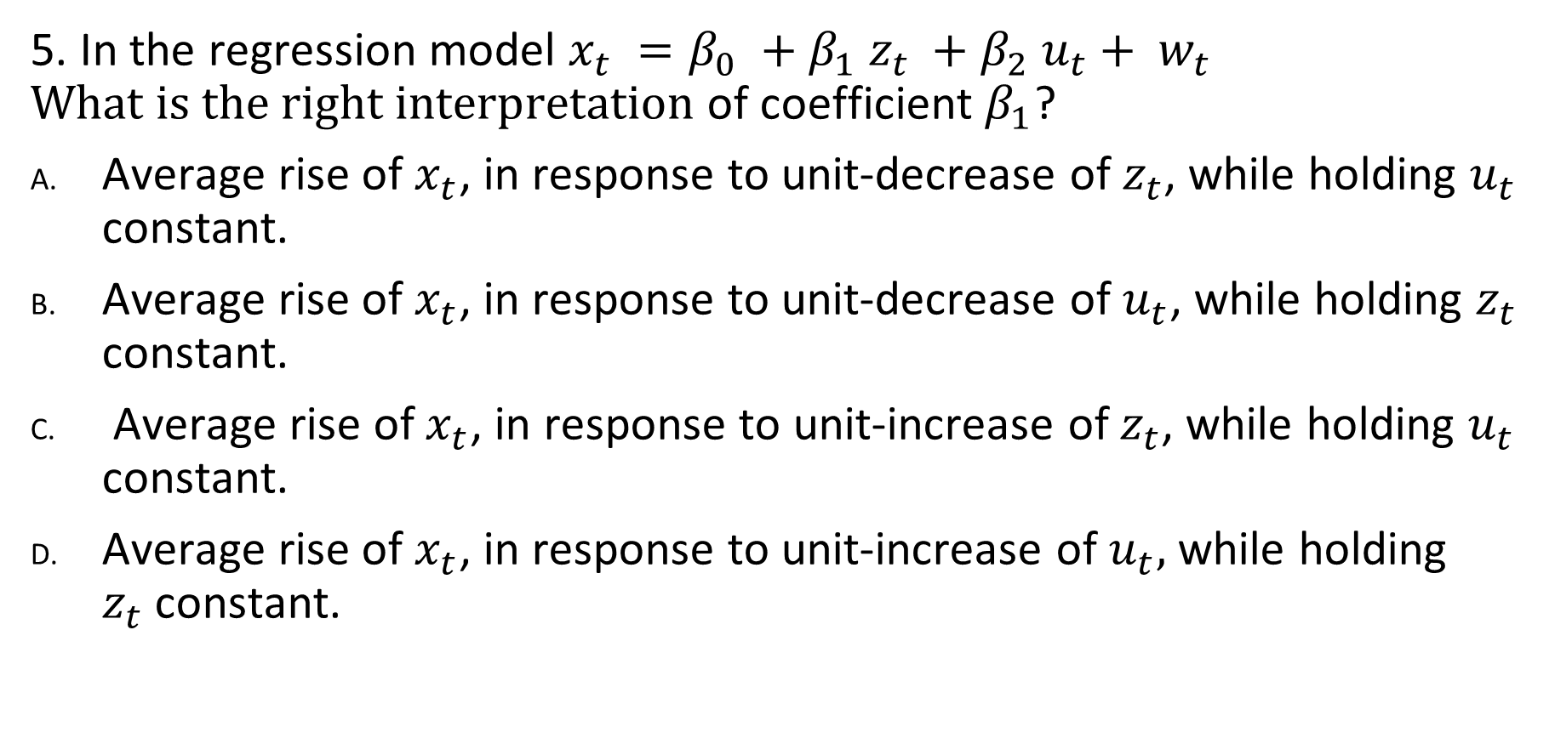
Regression quiz. Qualitative
5. In the regression model $x_{t} =β_{0} +β_{1} z_{t} +β_{2} u_{t}+ w_{t}$ $What is the right interpretation$ of coefficient $β_{1}$?
Average rise of $x_{t}$, in response to unit-decrease of $z_{t}$, while holding $u_{t}$ constant.
Average rise of $x_{t}$, in response to unit-decrease of $u_{t}$, while holding $z_{t}$ constant.
Average rise of $x_{t}$, in response to unit-increase of $z_{t}$, while holding $u_{t}$ constant.
Average rise of $x_{t}$, in response to unit-increase of $u_{t},$ while holding $z_{t}$constant.

Slide 19
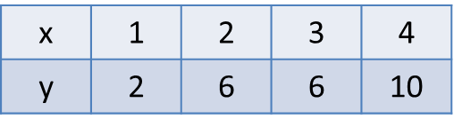
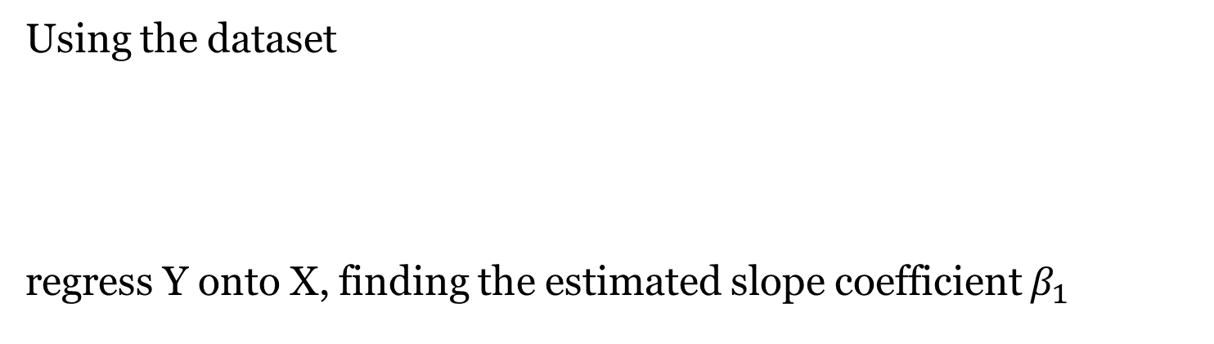
Regression quiz. Quantitative 1
Using the dataset
regress Y onto X, finding the estimated slope coefficient $β_{1}$
2.4
1.3
2.2
2

Slide 20
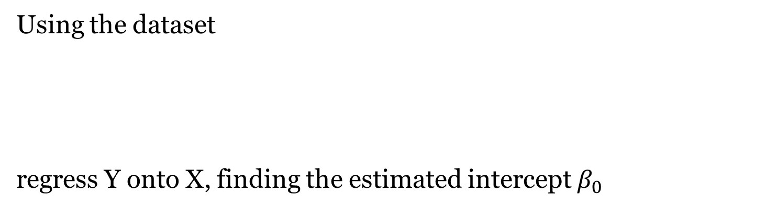
Regression quiz. Quantitative 2
Using the dataset
regress Y onto X, finding the estimated intercept $β_{0}$
0
1
2
3

Slide 21
Regression quiz. Quantitative 3
Using the dataset
regress Y onto X, finding the residual sum of squares RSS.
1.2
2.2
3.2
4.2

Slide 22
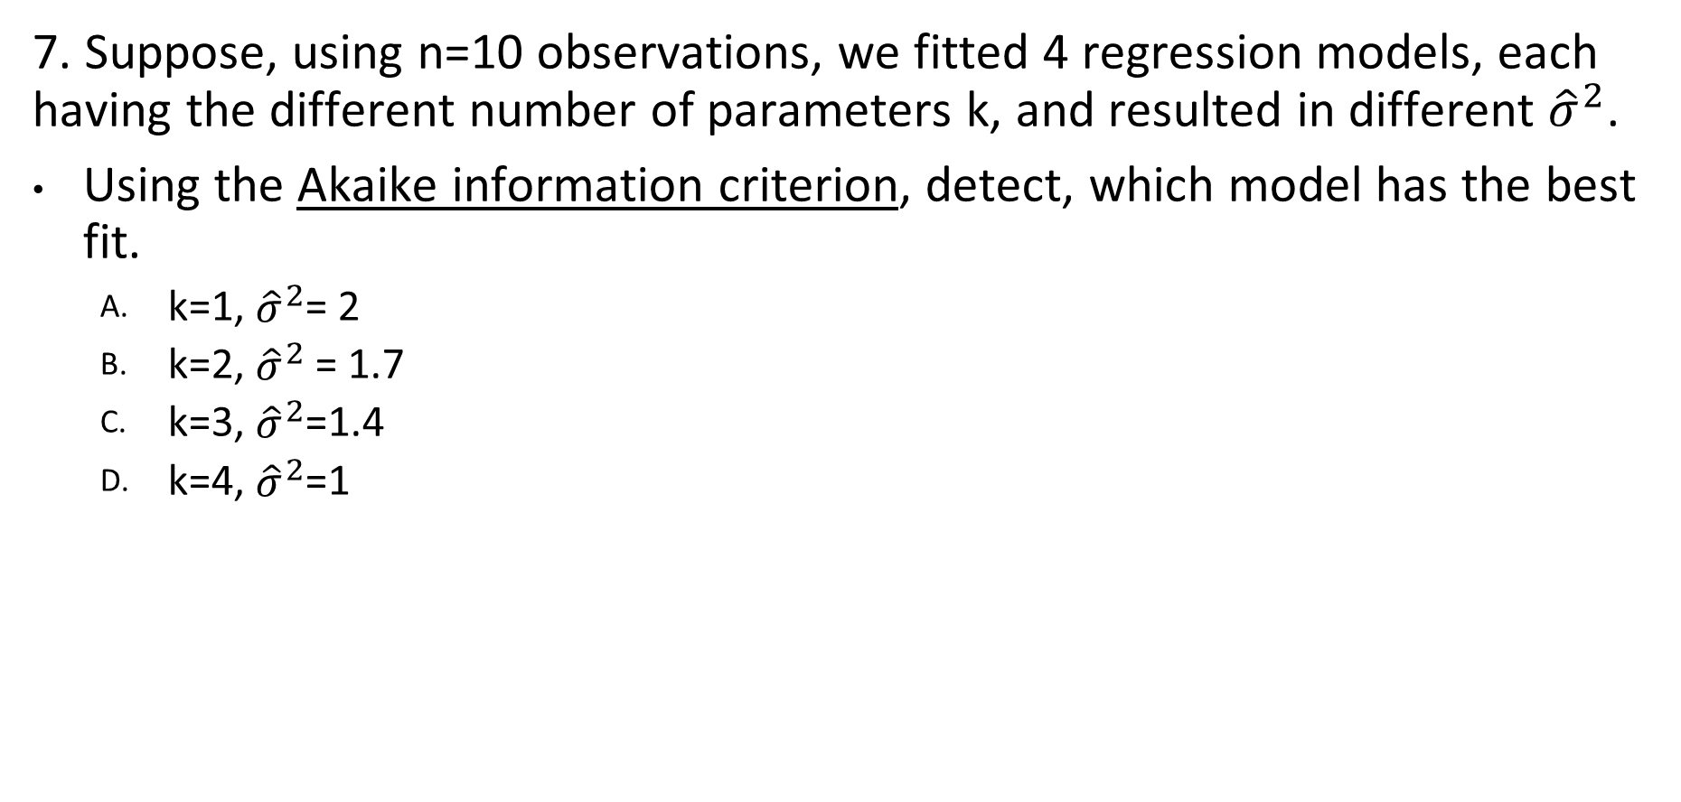
Regression quiz. Quantitative 4
7. Suppose, using n=10 observations, we fitted 4 regression models, each having the different number of parameters k, and resulted in different ${\hat{σ}}^{2}$.
Using the Akaike information criterion, detect, which model has the best fit.
k=1, ${\hat{σ}}^{2}$= 2
k=2, ${\hat{σ}}^{2}$ = 1.7
k=3, ${\hat{σ}}^{2}$=1.4
k=4, ${\hat{σ}}^{2}$=1

Slide 23
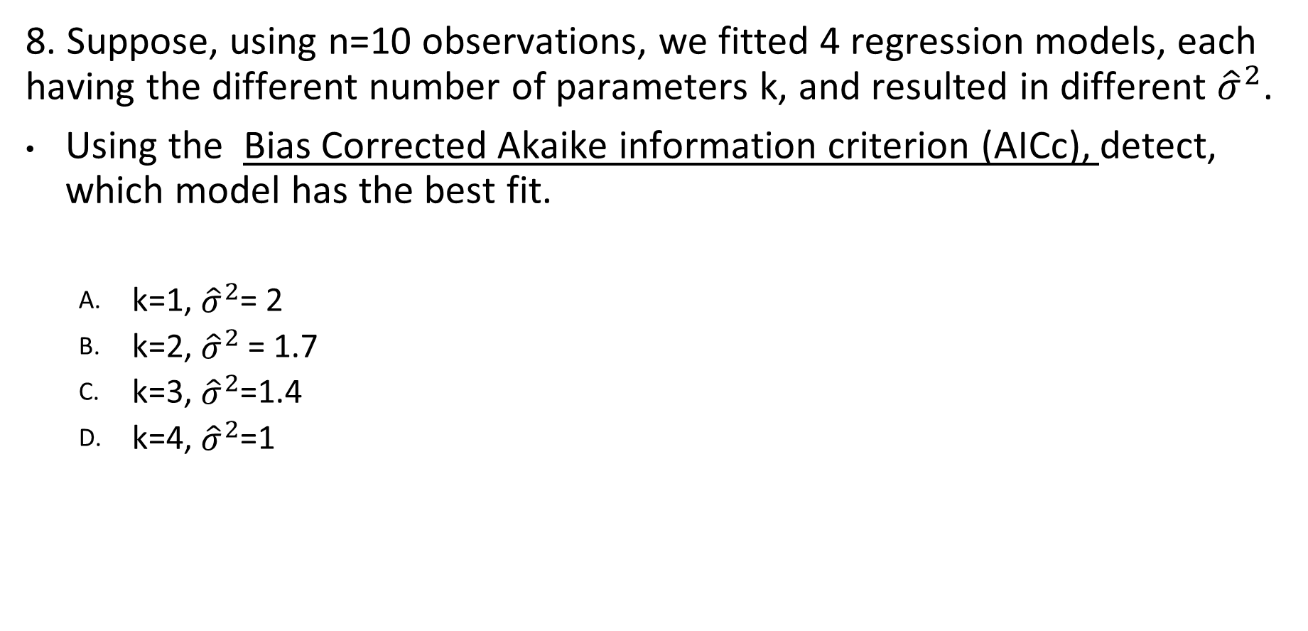
Regression quiz. Quantitative 5
8. Suppose, using n=10 observations, we fitted 4 regression models, each having the different number of parameters k, and resulted in different ${\hat{σ}}^{2}$.
Using the Bias Corrected Akaike information criterion (AICc), detect, which model has the best fit.
k=1, ${\hat{σ}}^{2}$= 2
k=2, ${\hat{σ}}^{2}$ = 1.7
k=3, ${\hat{σ}}^{2}$=1.4
k=4, ${\hat{σ}}^{2}$=1

Slide 24
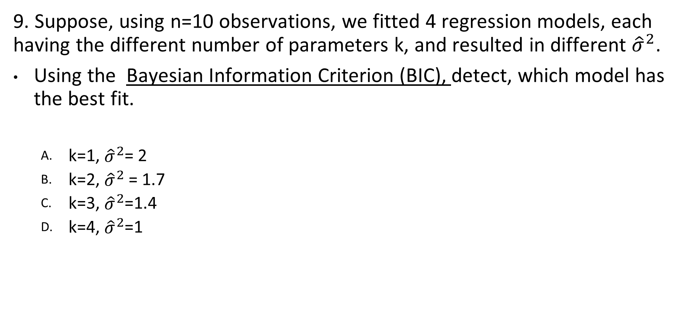
Regression quiz. Quantitative 6
9. Suppose, using n=10 observations, we fitted 4 regression models, each having the different number of parameters k, and resulted in different ${\hat{σ}}^{2}$.
Using the Bayesian Information Criterion (BIC), detect, which model has the best fit.
k=1, ${\hat{σ}}^{2}$= 2
k=2, ${\hat{σ}}^{2}$ = 1.7
k=3, ${\hat{σ}}^{2}$=1.4
k=4, ${\hat{σ}}^{2}$=1

Slide 25
Regression quiz practice. R. Question 1
We have:
x <- ts(11:15) + rnorm(5)
How can we regress x on its time?
lm(x ~ time(x))
predict(x)
lm(x ~ tsp(x))
lm(x ~ t(x))

Slide 26
Regression quiz practice. R. Question 2
We have two variables:
x <- rnorm(5)
y <- x + rnorm(5)
How can we perform regression without intercept?
lm(y ~ x - 0)
lm(y ~ x - intercept)
lm(y ~ 0 + x)
lm(y ~ x)

Slide 27
Regression quiz practice. R. Question 3
Suppose we have fit object that stores our regression model. How can we extract residuals from this object?
fit$residuals
res(fit)
fit$rank
fit$fitted.values

Slide 28
Chapter 2 Time Series Regression and Exploratory Data Analysis
2.2 Exploratory Data Analysis

Slide 29
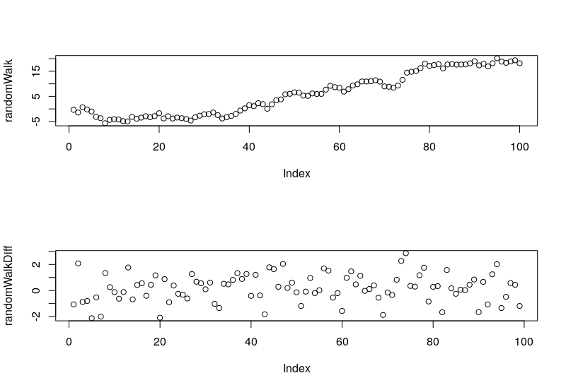
1. Difference kills continuity
n = 100 whiteNoise = rnorm(n=n) randomWalk = cumsum(whiteNoise) randomWalkDiff = diff(randomWalk) par(mfrow=c(2, 1)) plot(randomWalk)plot(randomWalkDiff)

Slide 30
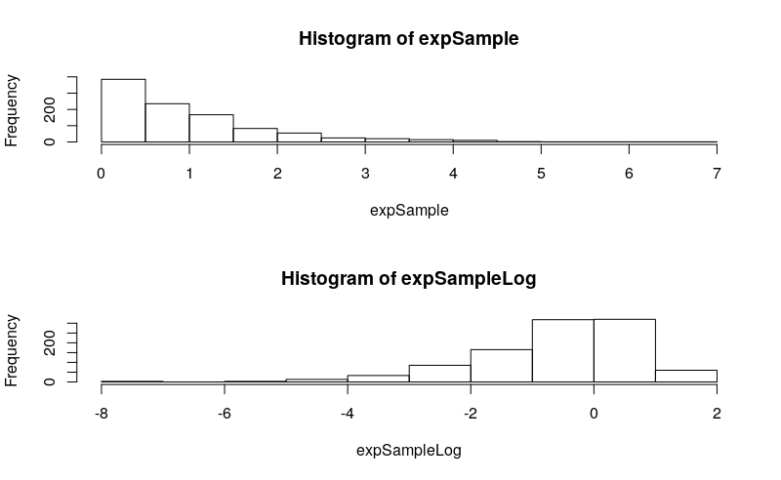
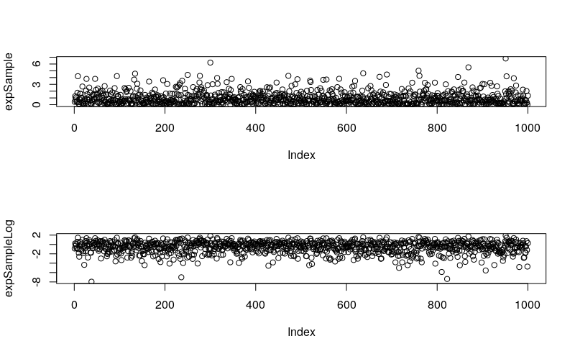
2. Logarithm and power < 1
# Symmetricizes positive distribution n = 1000 expSample = rexp(n=n) expSampleLog = log(expSample) hist(expSample) hist(expSampleLog) plot(expSample) plot(expSampleLog)

Slide 31
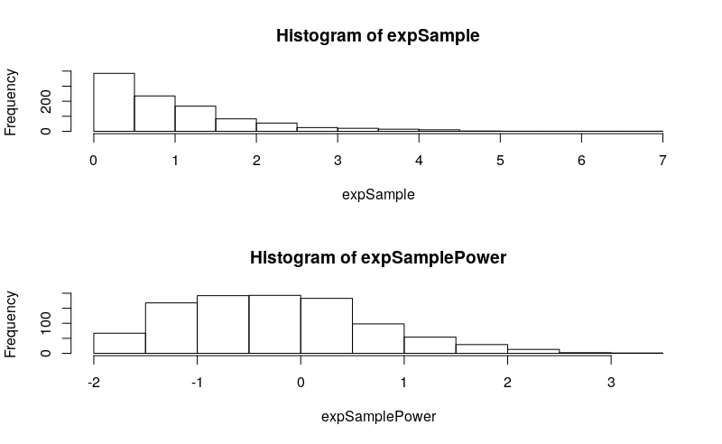
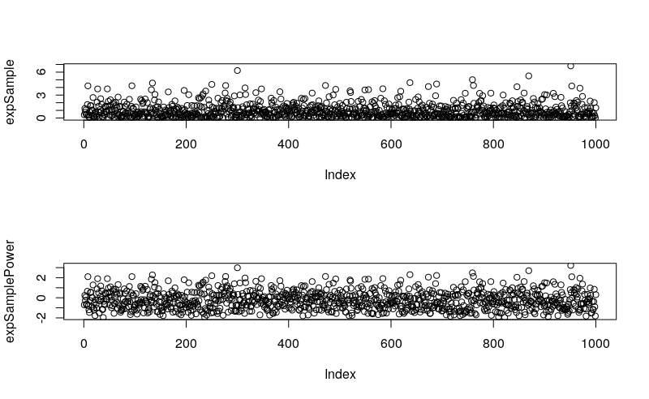
2a. Logarithm and power < 1
# too much, try power transformation lambda = ½ expSamplePower = (expSample^lambda - 1) / lambda hist(expSample) hist(expSamplePower)# show as time series plot(expSample) plot(expSamplePower)

Slide 32
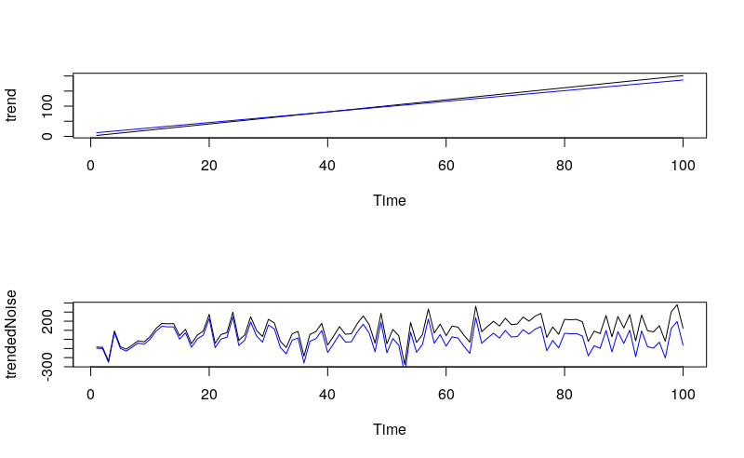
3. How to extract trend
n = 100 whiteNoise = ts(rnorm(n=n, sd = 100)) timeSequence = time(whiteNoise) beta0 = 1beta1 = 2trend = beta0 + beta1 * timeSequence trendedNoise = trend + whiteNoise fit = lm(trendedNoise ~ timeSequence) coef(fit) estimatedTrend = fitted(fit) plot(trend) lines(estimatedTrend, col = "blue") # detrend detrended = trendedNoise – estimatedTrend plot(trendedNoise) lines(detrended, col = "blue")

Slide 33
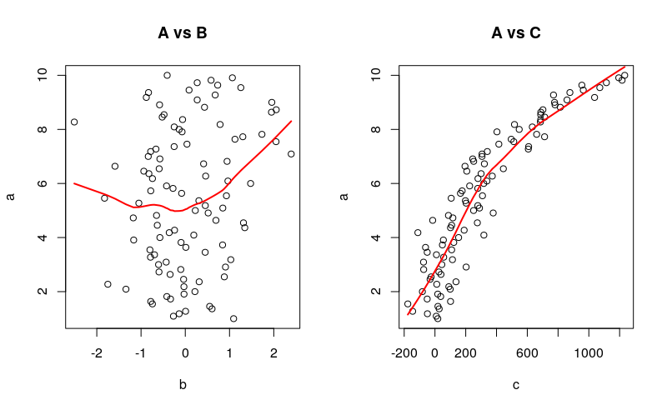
4. Choose a better regressor
a <- seq(from = 1, to = 10, length.out = 100) b <- rnorm(100)c <- a^3 + a^2 + rnorm(100, sd = 100) par(mfrow = c(1, 2)) plot(b, a, main = 'A vs B’) lines(lowess(b, a), col = 2, lwd = 2) plot(c, a, main = 'A vs C’) lines(lowess(c, a), col = 2, lwd = 2)

Slide 34
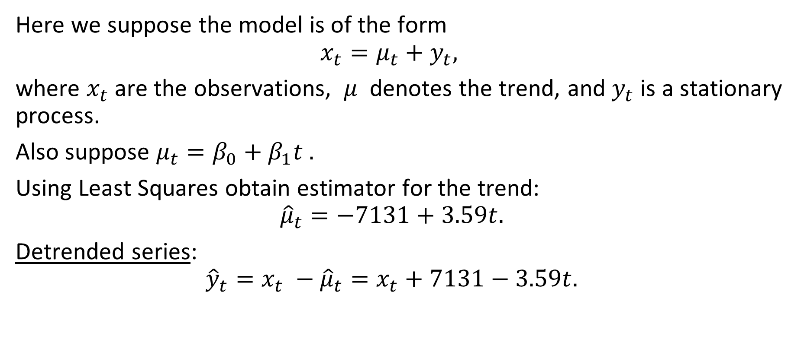
Example 2.4 Detrending Chicken Prices
Here we suppose the model is of the form
$$x_{t}=μ_{t}+y_{t},$$
where $x_{t}$are the observations, $μ$ denotes the trend, and $y_{t}$is a stationary process.
Also suppose $μ_{t}=β_{0}+β_{1}t .$
Using Least Squares obtain estimator for the trend:
$${\hat{μ}}_{t}=−7131+3.59t.$$
Detrended series:
$${\hat{y}}_{t}=x_{t} −{\hat{μ}}_{t}=x_{t}+7131−3.59t.$$

Slide 35
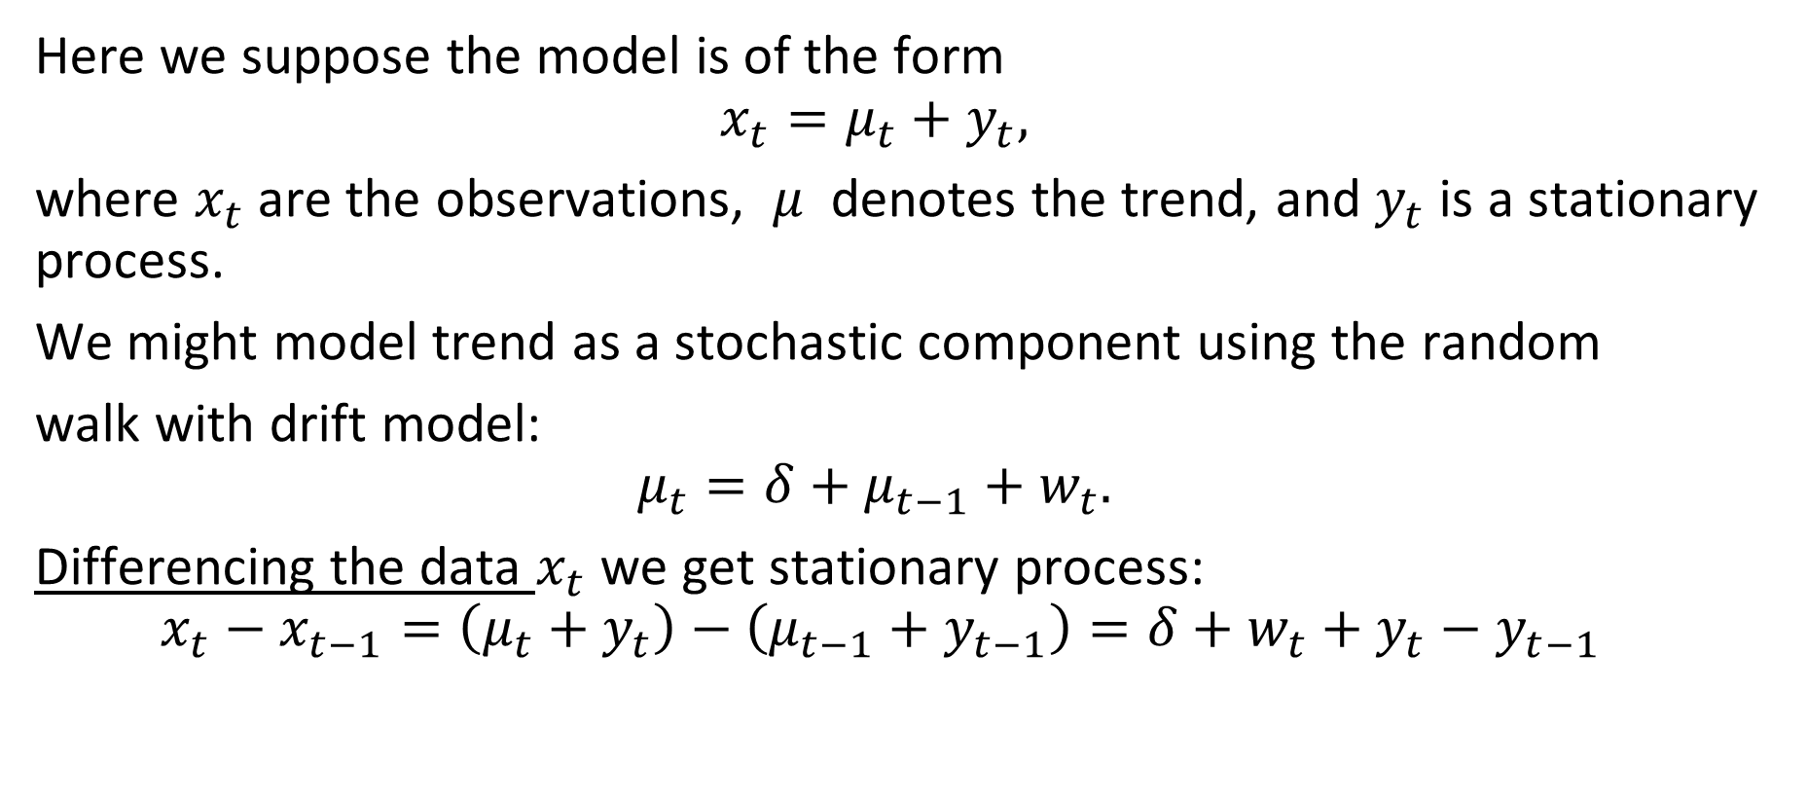
Example 2.4 continued. Differencing chicken data
Here we suppose the model is of the form
$$x_{t}=μ_{t}+y_{t},$$
where $x_{t}$are the observations, $μ$ denotes the trend, and $y_{t}$is a stationary process.
We might model trend as a stochastic component using the random
walk with drift model:
$$μ_{t}=δ+μ_{t−1}+w_{t}.$$
Differencing the data $x_{t}$ we get stationary process:
$$x_{t}−x_{t−1}=\left(μ_{t}+y_{t}\right)−\left(μ_{t−1}+y_{t−1}\right)=δ+w_{t}+y_{t}−y_{t−1}$$

Slide 36
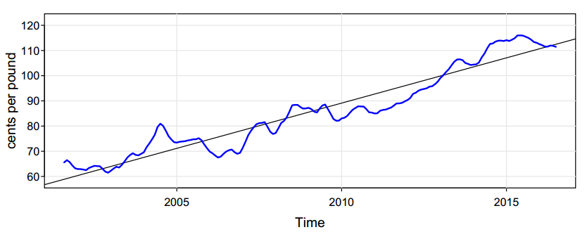
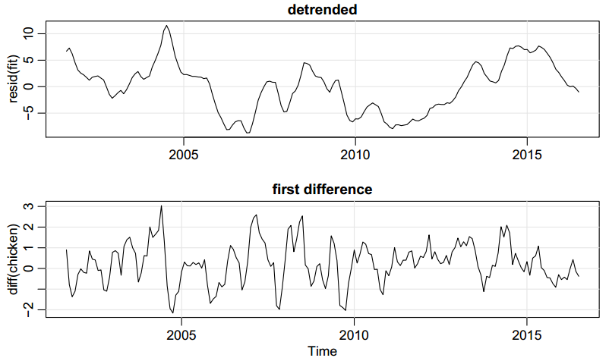
Example 2.4 continued. Comparing detrending and differencing
The original monthly whole bird spot chicken price
Detrended chicken price series.
Differenced chicken price series.

Slide 37
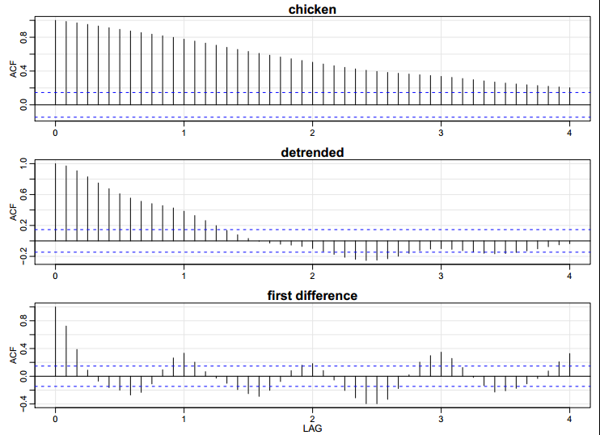
Example 2.5 Differencing Chicken Prices
fit = lm(chicken~time(chicken), na.action=NULL) # regress chicken on time
par(mfrow=c(2,1))
plot(resid(fit), type="o", main="detrended")
plot(diff(chicken), type="o", main="first difference")
par(mfrow=c(3,1)) # plot ACFs
acf(chicken, 48, main="chicken")
acf(resid(fit), 48, main="detrended")
acf(diff(chicken), 48, main="first difference")

Slide 38
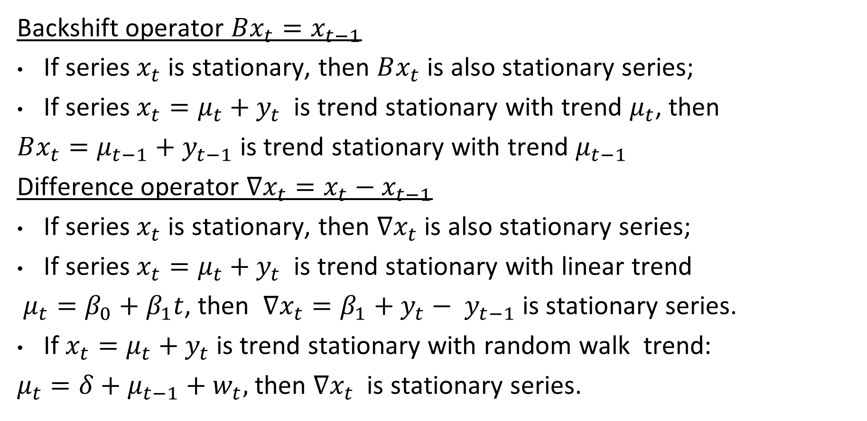
Properties of Shift and Difference operators
Backshift operator $Bx_{t}=x_{t−1}$
If series $x_{t}$ is stationary, then $Bx_{t}$ is also stationary series;
If series $x_{t}=μ_{t}+y_{t}$ is trend stationary with trend $μ_{t}$, then
$Bx_{t}=μ_{t−1}+y_{t−1}$is trend stationary with trend $μ_{t−1}$
Difference operator $∇x_{t}=x_{t}−x_{t−1}$
If series $x_{t}$ is stationary, then $∇x_{t}$ is also stationary series;
If series $x_{t}=μ_{t}+y_{t}$ is trend stationary with linear trend
$μ_{t}=β_{0}+β_{1}t$, then $∇x_{t}=β_{1}+y_{t}− y_{t−1}$is stationary series.
If $x_{t}=μ_{t}+y_{t}$ is trend stationary with random walk trend:
$μ_{t}=δ+μ_{t−1}+w_{t},$ then ${∇x}_{t}$is stationary series.

Slide 39
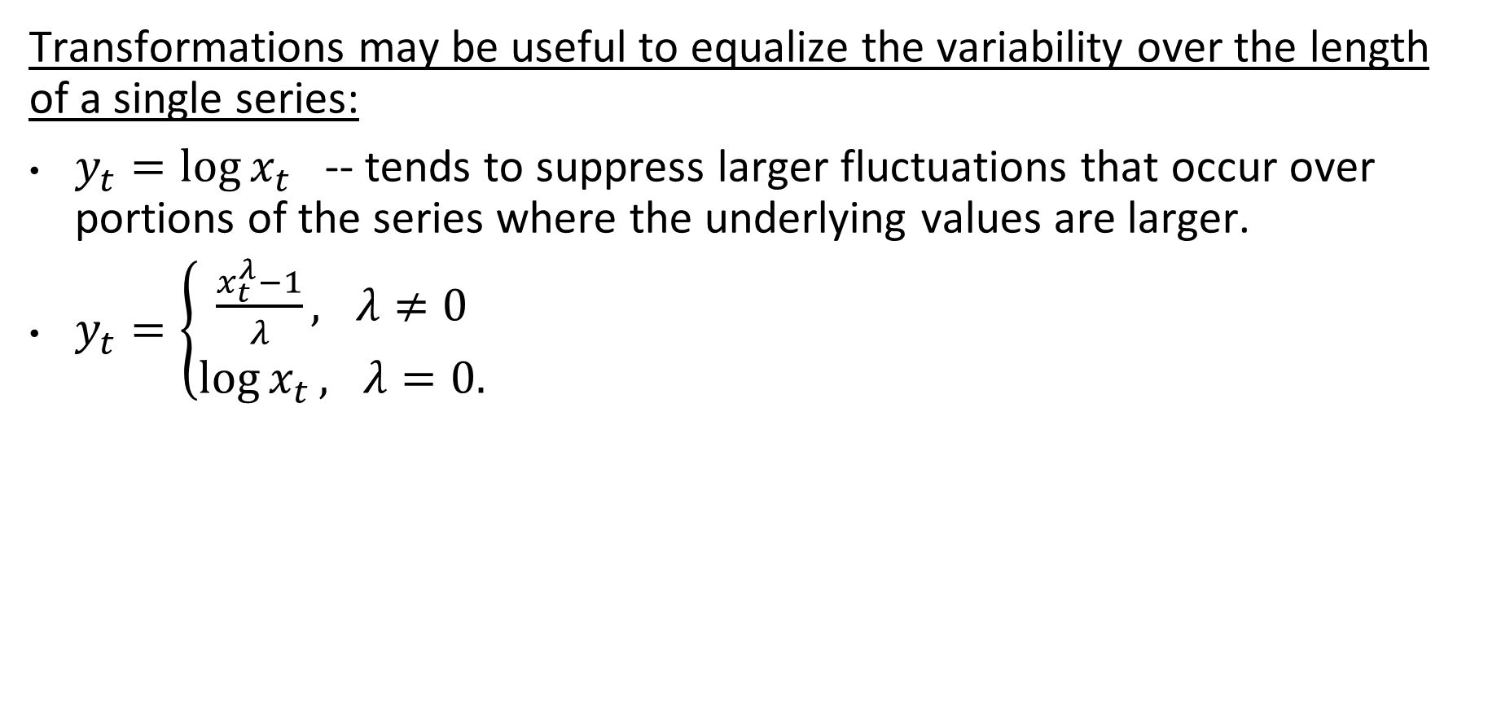
Transformation of series.
Transformations may be useful to equalize the variability over the length of a single series:
$y_{t}=\log{x_{t}}$ -- tends to suppress larger fluctuations that occur over portions of the series where the underlying values are larger.
$y_{t}=\left\{\begin{aligned}\frac{x_{t}^{λ}−1}{λ}, λ≠0 \\ \log{x_{t}}, λ=0.\end{aligned}\right.$

Slide 40
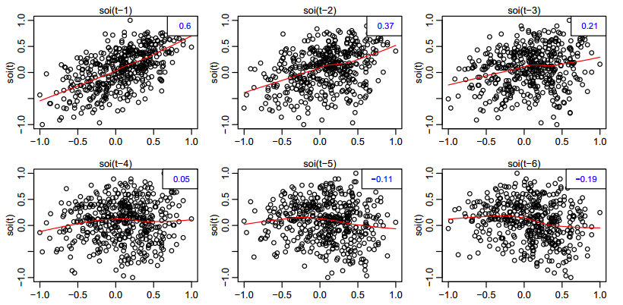
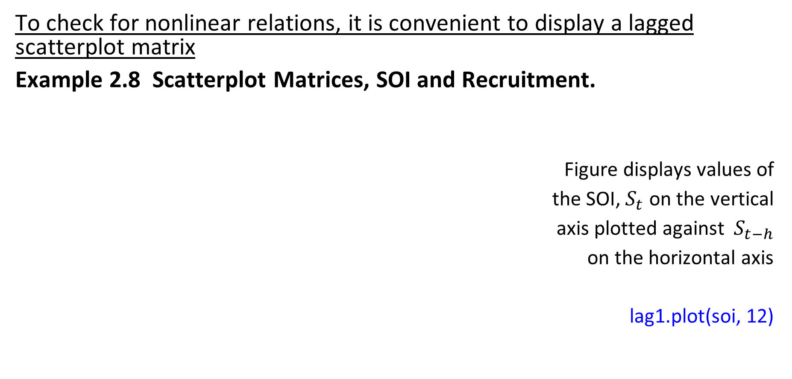
Scatterplot matrices.
To check for nonlinear relations, it is convenient to display a lagged scatterplot matrix
Example 2.8 Scatterplot Matrices, SOI and Recruitment.
Figure displays values of
the SOI, $S_{t}$ on the vertical
axis plotted against $S_{t−h}$
on the horizontal axis
lag1.plot(soi, 12)

Slide 41
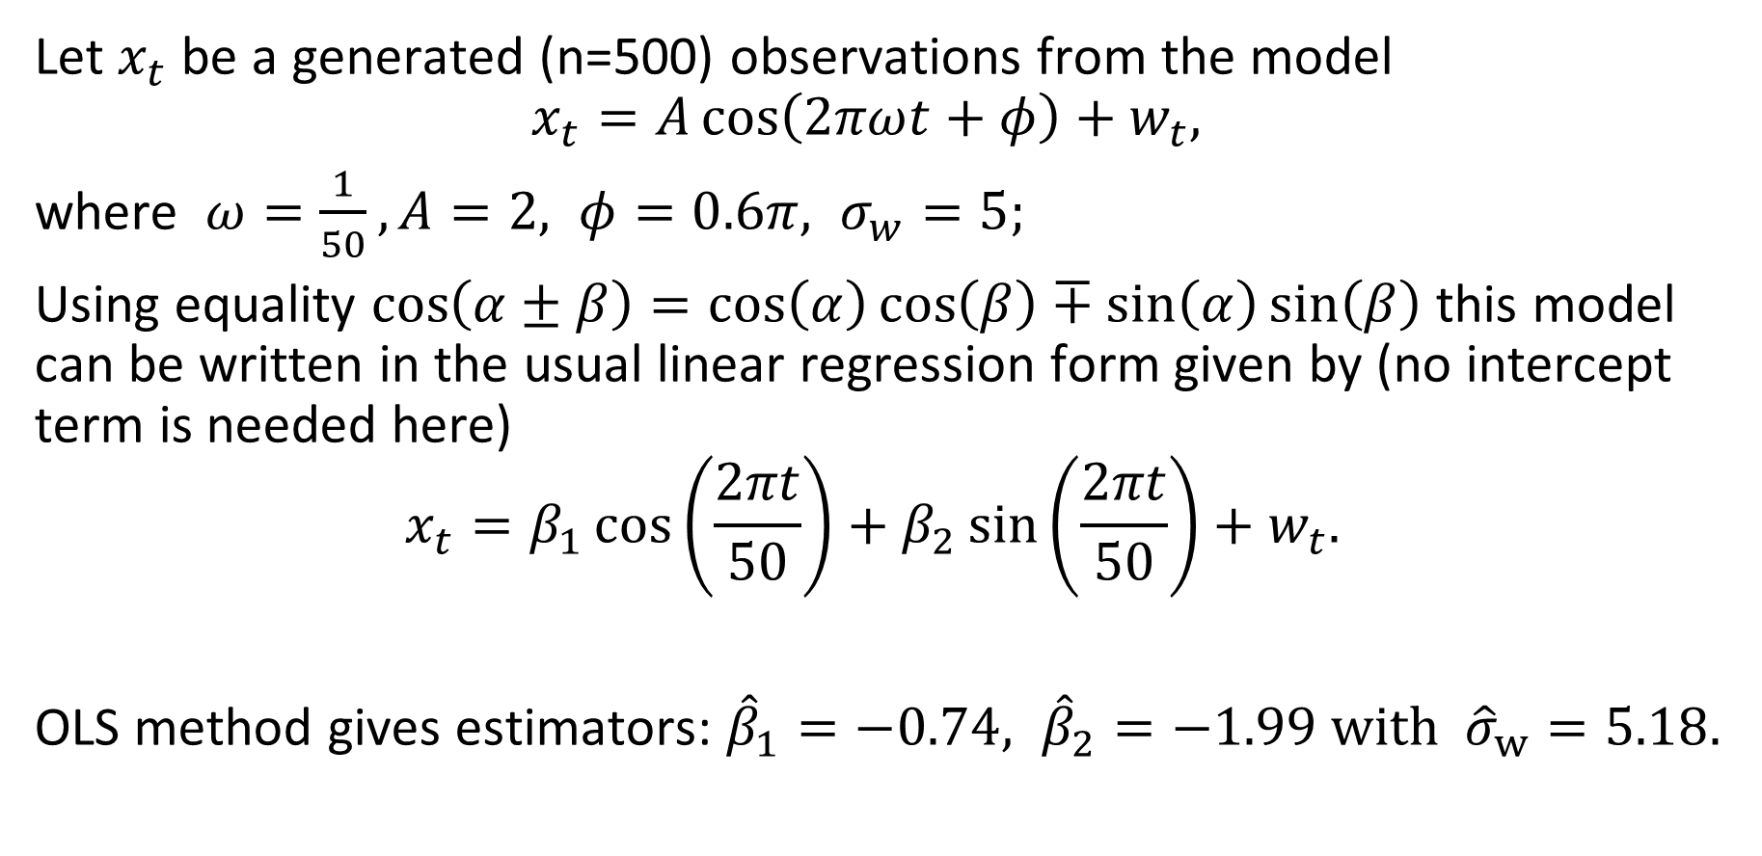
Example 2.10 Using Regression to Discover a Signal in Noise
Let $x_{t}$ be a generated (n=500) observations from the model
$$x_{t}=A\cos\left(2πωt+φ\right)+w_{t},$$
where $ω=\frac{1}{50}, A=2, φ=0.6π, σ_{w}=5;$
Using equality $\cos\left(α±β\right)=\cos\left(α\right)\cos\left(β\right)∓\sin\left(α\right)\sin\left(β\right)$ this model can be written in the usual linear regression form given by (no intercept term is needed here)
$$x_{t}=β_{1}\cos\left(\frac{2πt}{50}\right)+β_{2}\sin\left(\frac{2πt}{50}\right)+w_{t}.$$
OLS method gives estimators: ${\hat{β}}_{1}=−0.74, {\hat{β}}_{2}=−1.99 with {\hat{σ}}_{w}=5.18.$

Slide 42
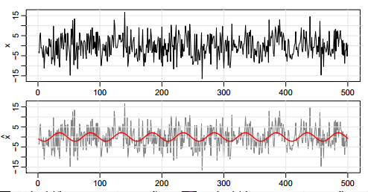
Example 2.10 continued. Using Regression to Discover a Signal in Noise
set.seed(90210) # so you can reproduce these results
x = 2*cos(2*pi*1:500/50 + .6*pi) + rnorm(500,0,5)
z1 = cos(2*pi*1:500/50)
z2 = sin(2*pi*1:500/50)
summary(fit <- lm(x~0+z1+z2)) # zero to exclude the intercept
Coefficients:
Estimate Std. Error t value
z1 -0.7442 0.3274 -2.273
Z2 -1.9949 0.3274 -6.093
Residual standard error:
5.177 on 498 degrees of freedom
par(mfrow=c(2,1))
plot.ts(x)
plot.ts(x, col=8, ylab=expression(hat(x)))
lines(fitted(fit), col=2

Slide 43
Exploratory analysis quiz. Qualitative 1
1. We perform an exploratory analysis of a time series to extract structural features, thus converting the series to chaotic. Our original series looks continuous. Which operation seems appropriate to remove continuity?
Difference
Logarithm
Backshift
Multiplication by a constant

Slide 44
Exploratory analysis quiz. Qualitative 2
2. We perform an exploratory analysis. The distribution of our time series seems right skewed, so the small values occur more often than the large ones. We want to symmetricize the distribution. Which operation is appropriate?
Difference
Logarithm
Backshift
Multiplication by a constant

Slide 45
Exploratory analysis quiz. Qualitative 3
3. We perform an exploratory analysis. The series seems to follow some trend. How to extract it?
Regress the original series onto some function, and subtract the fitted values from the original.
Regress the original series onto some function, and subtract the residuals from the original.
Apply a lagged difference.
Apply logarithm

Slide 46
Exploratory analysis quiz. Qualitative 4
4. We perform an exploratory analysis of the series of asset A prices. We also have two other series - price of asset B and price of asset C. We want to choose between B and C - which one is a better predictor for A. Below we have scatter plots of (A vs B) and (A vs C). Which predictor would you choose?
B
C
Neither
Can not be determined

Slide 47
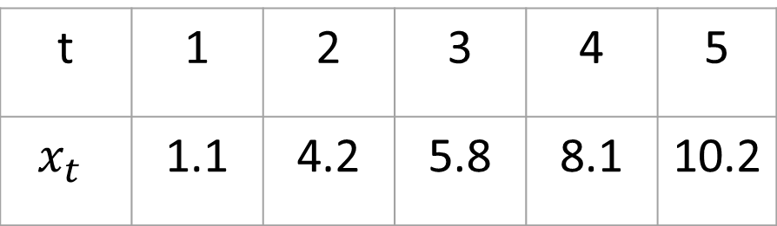
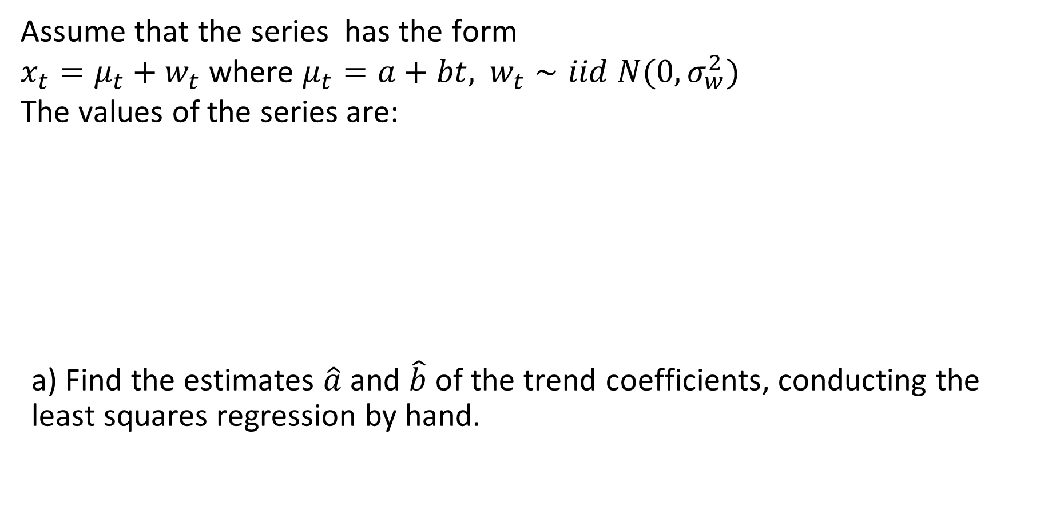
Exploratory analysis quiz. Quantitative 1
Assume that the series has the form
$x_{t}=μ_{t}+w_{t}$ where $μ_{t}=a+bt,$ $w_{t}∼iid N(0,σ_{w}^{2})$
The values of the series are:
a) Find the estimates $\hat{a}$ and $\hat{b}$ of the trend coefficients, conducting the least squares regression by hand.
t | 1 | 2 | 3 | 4 | 5
$$x_{t}$$ | 1.1 | 4.2 | 5.8 | 8.1 | 10.2

Slide 48
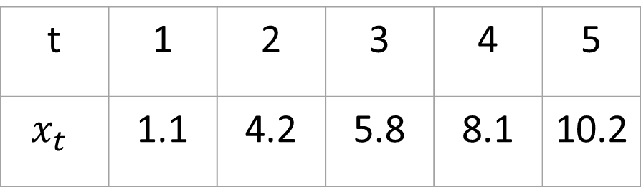
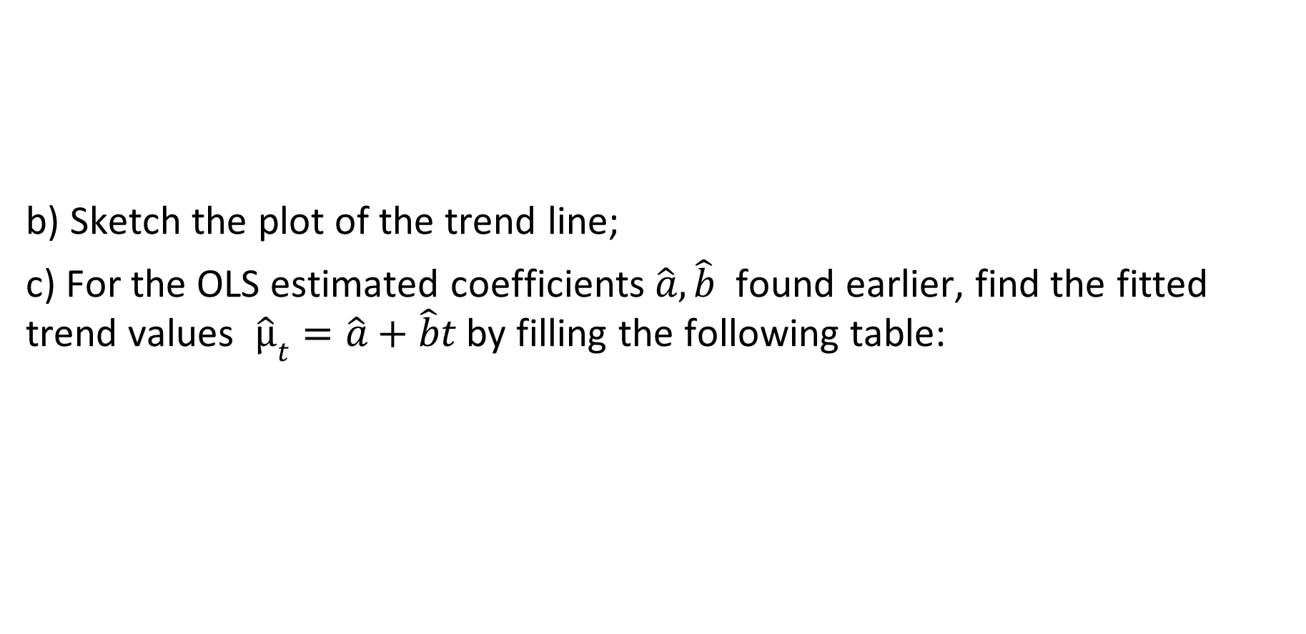
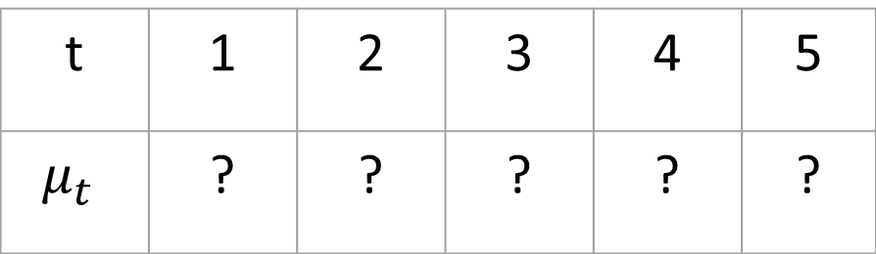
Exploratory analysis quiz. Quantitative 2
t | 1 | 2 | 3 | 4 | 5
$$x_{t}$$ | 1.1 | 4.2 | 5.8 | 8.1 | 10.2
b) Sketch the plot of the trend line;
c) For the OLS estimated coefficients $\hat{a}, \hat{b}$ found earlier, find the fitted trend values ${\hat{μ}}_{t}=\hat{a}+\hat{b}t$by filling the following table:
t | 1 | 2 | 3 | 4 | 5
$$μ_{t}$$ | ? | ? | ? | ? | ?

Slide 49
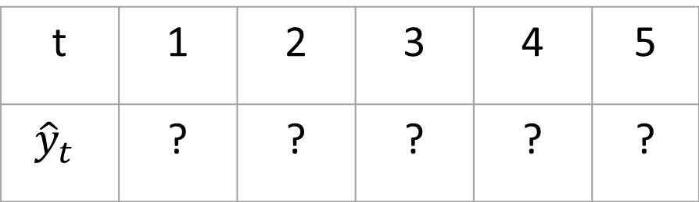
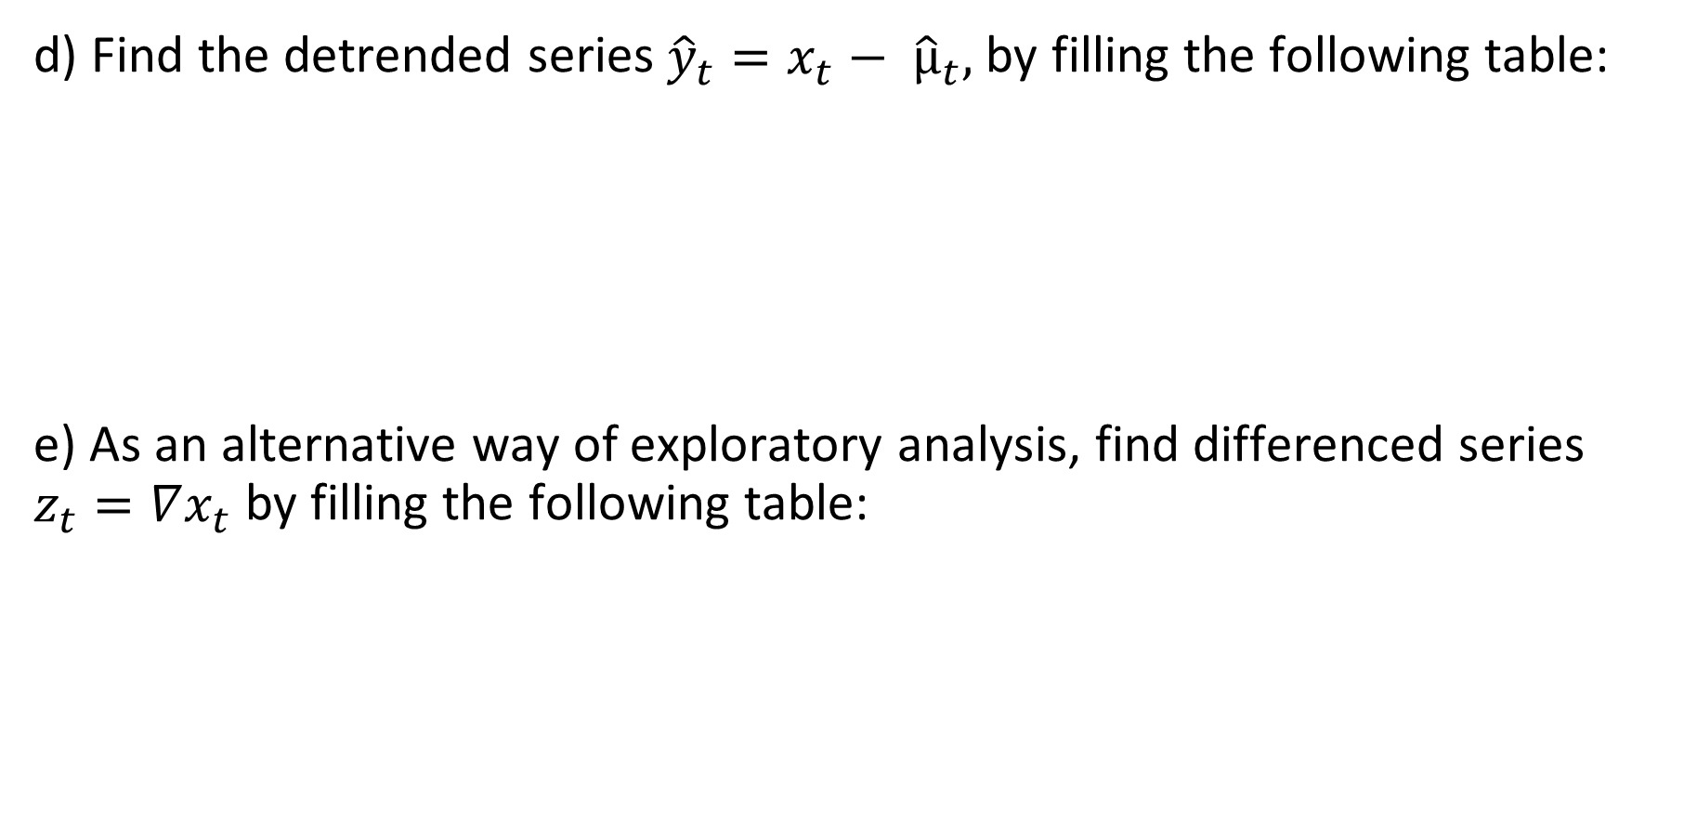
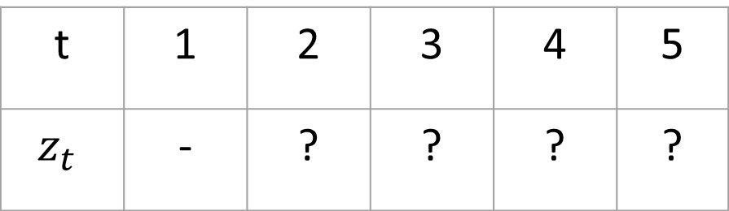
Exploratory analysis quiz. Quantitative 3
d) Find the detrended series ${\hat{y}}_{t}=x_{t}− {\hat{μ}}_{t},$by filling the following table:
e) As an alternative way of exploratory analysis, find differenced series $z_{t}=∇x_{t}$by filling the following table:
t | 1 | 2 | 3 | 4 | 5
$${\hat{y}}_{t}$$ | ? | ? | ? | ? | ?
t | 1 | 2 | 3 | 4 | 5
$$z_{t}$$ | - | ? | ? | ? | ?

Slide 50
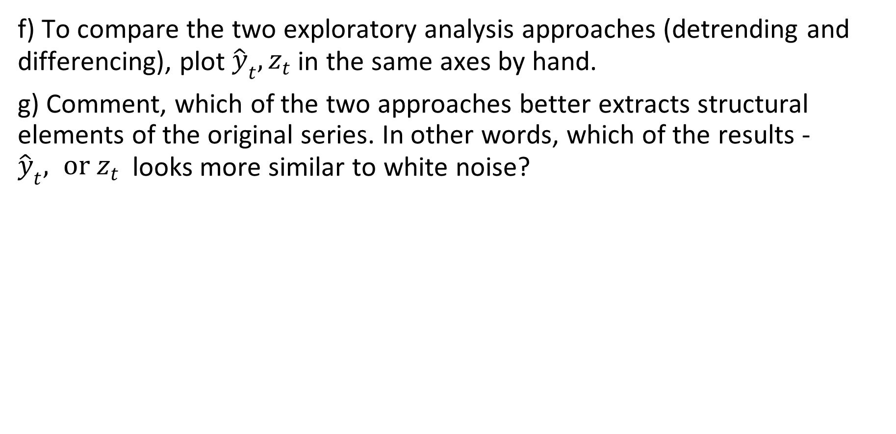
Exploratory analysis quiz. Quantitative 4
f) To compare the two exploratory analysis approaches (detrending and differencing), plot ${\hat{y}}_{t}, z_{t}$in the same axes by hand.
g) Comment, which of the two approaches better extracts structural elements of the original series. In other words, which of the results - ${\hat{y}}_{t}, or z_{t}$looks more similar to white noise?

Slide 51
Exploratory analysis quiz. R. Question 1
whiteNoise = ts(rnorm(n=100, sd=100))
timeSequence = time(whiteNoise)
beta0 = 1
beta1 = 2
trend = beta0 + beta1 * timeSequence
trendedNoise = trend + whiteNoise
myFit = lm(trendedNoise ~ timeSequence)
How to extract the trend?
y = trendedNoise - fitted(myFit)
y = trendedNoise + fitted(myFit)
y = trendedNoise - res(myFit)
y = trendedNoise + res(myFit)

Slide 52
Chapter 2 Time Series Regression and Exploratory Data Analysis
2.3 Smoothing in the Time Series Context

Slide 53

Moving average smoother
Filtering or smoothing method is useful in discovering certain traits in a time series, such as long-term trend and seasonal components.
Symmetric moving average of the data:
$$m_{t}= \sum_{j=−k}^{k}{a_{j}x_{t−j},}$$
where $a_{j}=a_{−j}≥0$ and $\sum_{j=−k }^{k}{a_{j}}=1$

Slide 54


Example 2.11 Moving average smoother
For the SOI series, consider smoother with weights
$a_{0}=a_{±1}=…=a_{±5}=\frac{1}{12}$ and $a_{±6}=1/24$
wgts = c(.5, rep(1,11), .5)/12
soif = filter(soi, sides=2, filter=wgts)
plot(soi)
lines(soif, lwd=2, col=4)
par(fig = c(.65, 1, .65, 1), new = TRUE) # the insert
nwgts = c(rep(0,20), wgts, rep(0,20))
plot(nwgts, type="l", ylim = c(-.02,.1),
xaxt='n', yaxt='n', ann=FALSE)

Slide 55

Kernel smoother
https://en.wikipedia.org/wiki/Kernel_(statistics)
https://en.wikipedia.org/wiki/Kernel_regression
The Nadaraya-Watson smoother
$$m_{t}= \sum_{i=1}^{n}{w_{i}\left(t\right)x_{i},}$$
where
$$w_{i}\left(t\right)={K\left(\frac{t−i}{b}\right)}/{\sum_{j=1}^{n}{K\left(\frac{t−j}{b}\right)}}$$
are weights, and $K$is a kernel function.
Example of Kernel: Normal kernel $K\left(z\right)=\frac{1}{\sqrt{2π}}\exp\left(−\frac{z^{2}}{2}\right)$

Slide 56

Kernel smoother
plot(soi)
lines(ksmooth(time(soi), soi, "normal", bandwidth=1), lwd=2, col=4)
par(fig = c(.65, 1, .65, 1), new = TRUE) # the insert
gauss = function(x) { 1/sqrt(2*pi) * exp(-(x^2)/2) }
x = seq(from = -3, to = 3, by = 0.001)
plot(x, gauss(x), type ="l", ylim=c(-.02,.45), xaxt='n', yaxt='n', ann=FALSE)

Slide 57

Lowess
Another approach to smoothing a time plot is nearest neighbor regression. The technique is based on k -nearest neighbors regression, wherein one uses only the data
$$\{x_{t−k/2},…x_{t},…x_{t+k/2}\}$$
to predict $x_{t}$ via regression.
The larger the fraction of nearest neighbors included, the
smoother the fit will be.
https://en.wikipedia.org/wiki/Local_regression

Slide 58

Example: lowess
plot(soi)
lines(lowess(soi, f=.05), lwd=2, col=4) # El Nino cycle
lines(lowess(soi), lty=2, lwd=2, col=2)) # trend (with default span)

Slide 59

Smoothing Splines
An obvious way to smooth data would be to fit a polynomial regression in terms of time. For example, a cubic polynomial:
$$m_{t}=β_{0}+β_{1}t+β_{2}t^{2}+β_{3}t^{3}.$$
An extension of polynomial regression is to first divide time $t = 1,…,n,$into k intervals, $\left[t_{0}=1, t_{1}\right], \left[t_{1}+1, t_{2}\right],…,\left[t_{k−1}+1,t_{k}=n\right];$
the values $t_{0}, t_{1},…, t_{k}$ are called knots.
Then, in each interval, one fits a polynomial regression, typically the order is 3, and this is called cubic splines.

Slide 60

Smoothing Splines continued
A related method is smoothing splines, which minimizes a compromise between the fit and the degree of smoothness given by
$$\sum_{t=1}^{n}{{\left[x_{t}−m_{t}\right]}^{2}}+λ\int{{\left(m_{t}^{′′}\right)}^{2}dt}$$
where $m_{t}$ is a cubic spline with a knot at each t and primes denote differentiation.
The degree of smoothness is controlled by $λ$ > 0.
If $λ$= 0, we don’t care how choppy the ride is, and this leads to $m_{t}=x_{t}$, the
data, which are not smooth.
If $λ$ = 1, we insist on no acceleration or deceleration ($m_{t}^{′′}=0)$; in this case, $m_{t} = c + v_{t}$, and consequently very smooth.

Slide 61


Example: Spline
In R, the smoothing parameter is called spar and it is monotonically related to $λ.$
plot(soi)
lines(smooth.spline(time(soi), soi, spar=.5), lwd=2, col=4)
lines(smooth.spline(time(soi), soi, spar= 1), lty=2, lwd=2, col=2)

Slide 62

Smoothing quiz practice. Theory. Question 1
For time series smoothing, the moving average filter is often applied:
$$m_{t} =\sum_{k=−j}^{j}{a_{k}w_{t−k}}$$
for different j. Consider two values of hyperparameter j: j=2 and j=10. For which value of j is the result $m_{t}$ smoother:
When j=2.
When j=10.
The smoothness does not depend on j.
Can not be determined.

Slide 63
Smoothing quiz practice. Theory. Question 2
Is it possible to write a moving average smoother as a kernel smoother?
Yes
No
For some moving average smoother it is possible, but for some - not.

Slide 64
Smoothing quiz practice. Theory. Question 3
Consider the following regression input table with 3 x-y pairs:
X: 1, 2, 4
Y: 5, 7, 6
We need to regress Y onto X, using LOESS or KNN procedure. Use the hyperparameter ratio=2/3.
Convert the ratio into an absolute number of nearest neighbours K.
K = 1
K = 2
K = 3
K = 4

Slide 65

Smoothing quiz practice. Theory. Question 4
As in the previous question, consider the following regression input table with 3 x-y pairs:
X: 1, 2, 4
Y: 5, 7, 6
We need to regress Y onto X, using LOESS or KNN procedure. Use the hyperparameter ratio=2/3.
Evaluate the fitted value $\hat{y}(x=1.5)$.
5
5.5
6
6.5

Slide 66
Smoothing quiz practice. Theory. Question 5
Which smoothing method partitions the predictor's domain and fits a separate function at each part?
Moving average smoothing
Kernel smoothing
LOWESS smoothing
Spline smoothing

Slide 67



Smoothing quiz practice. Question 6
For the following series $x_{t}$
a) find moving average values $m_{t}$, using the weights $a_{−1}=a_{0}=a_{1}=\frac{1}{3}$
t | 1 | 2 | 3 | 4 | 5 | 6
$$x_{t}$$ | 5 | -1 | 3 | 0 | 7 | 2
t | 1 | 2 | 3 | 4 | 5 | 6
$$m_{t}$$

Slide 68


Smoothing quiz practice. Question 6
For the following series $x_{t}$
b) find kernel smoother values $y_{t}$, using the kernel $K\left(x\right)= \left\{\begin{aligned}1+x, x∈[−1,0] \\ 1−x, x∈[0,1] \\ 0, x∉[−1,1]\end{aligned}\right.$ with bandwidth b = 1
t | 1 | 2 | 3 | 4 | 5 | 6
$$x_{t}$$ | 5 | -1 | 3 | 0 | 7 | 2
t | 1 | 2 | 3 | 4 | 5 | 6
$$y_{t}$$

Slide 69
Smoothing quiz practice. R. Question 1
What R function will perform kernel smoothing?
smooth.spline()
ksmooth()
lowess()
gauss()

Slide 70
Smoothing quiz practice. R. Question 2.
Which R function will perform K nearest neighbors regression?
smooth.spline()
ksmooth()
lowess()
gauss()

Slide 71
Smoothing quiz practice. R. Question 3.
What R function will perform spline smoothing?
smooth.spline()
ksmooth()
lowess()
gauss()

Slide 72

Smoothing quiz practice. R. Question 4.
library(astsa)
plot.ts(soi)
fractionRed = ?
fractionBlue = ?
lines(lowess(soi, f=fractionRed), lwd = 2, col = "red")
lines(lowess(soi, f=fractionBlue), lwd = 2, col = "blue")
The code above produces the image provided. Fill the question marks in the code, choosing the possible fraction values:
fractionRed = 1/10, fractionBlue = 2/3
fractionRed = 2/3, fractionBlue = 1/10
fractionRed = 1/10, fractionBlue = 1/10
fractionRed = 2/3, fractionBlue = 2/3

